Slide 1
Gender Studies Act-7 Ms. Lindsay
Aim: What is it like to use research methods?
Do Now (IN YOUR GROUP): What is the first step to PAR? How can you complete this step?
HW Due Today: None
Notes:
12 mins for Do Now

Slide 2
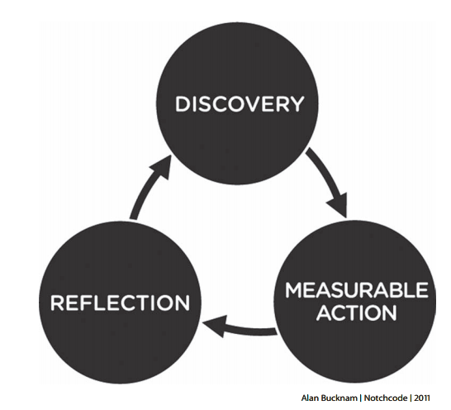
Notes:
Today, we’ll start looking at discovery – 2 mins

Slide 3
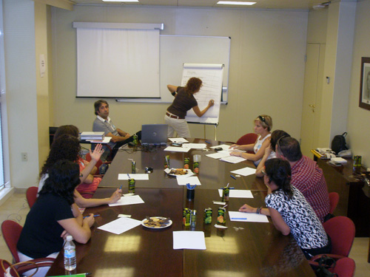
interview
Individual, group
Informal (conversation), standardized
open-ended, closed (choose from preset answers)

Slide 4
Create your own interview questions!
CHOOSE:
Topic (what will you ask about?)
# of people (individual or group interview)
Open-ended or closed response (can they answer however they want or do you want them to pick from a set of answers you created?)
As a group, write a set of questions for a 4 minute interview. (if it’s a group interview, it will be fewer questions)

Slide 5
survey, opinion poll

Slide 6
Create your own survey!
CHOOSE:
Topic (what will you ask about?)
Open-ended or closed response (can they answer however they want or do you want them to pick from a set of answers you created?)
As a group, write a set of questions for the whole class to answer quickly (the survey should take about 2-3 minutes). The answer choices for each question should be a rating. (Example: Strongly Agree, Agree, Neutral, Disagree, Strongly Disagree)
Notes:
Remember: define important terms & write rating “questions” as statements instead of questions, make sure people know about the topic, should be more opinion & less fact-based

Slide 7
mapping

Slide 8
Make a map of your assets!
Look at the map of the area around our school.
Each person should draw at least:
1 green dot where you eat lunch
1 blue dot where you like to go
1 red dot where you do not like to go or feel unsafe

Slide 9
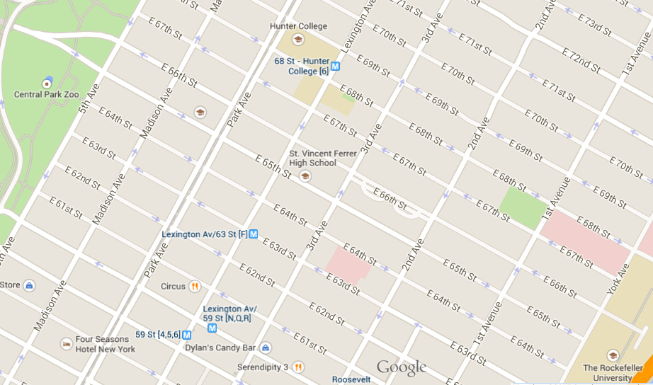

Slide 10
observation journal

Slide 11
Create your own observation journal!
You will sit in the 4th floor hallway during this exercise, paying attention to students leaving class.
Write anything you see or hear that you think is important.
MOST IMPORTANTLY: you are an observer, so you cannot talk or interact with others, just watch!

