Slide 1
Gender Studies Act-8 Ms. Lindsay
Aim: How can we use a “problem tree” in our research?
Do Now (ON YOUR OWN): What is the difference between a symptom and a cause? Give an example.
HW Due Today: None
Notes:
12 mins for Do Now

Slide 2
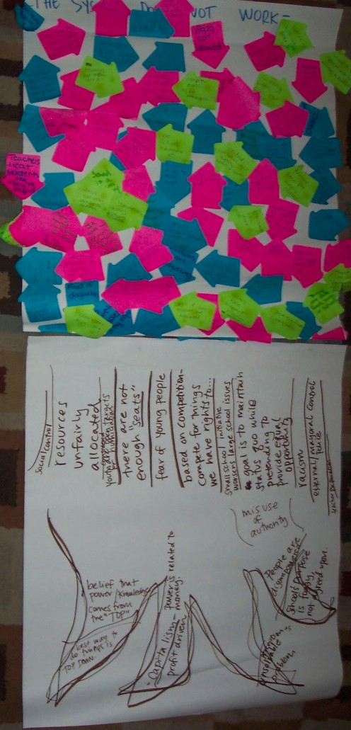

Slide 3
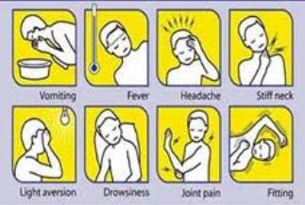
Steps to Create a Problem Tree
1. Identify the problem
2. What are the symptoms?
3. What are the attitudes/beliefs that keep these symptoms alive?
4. What are the systemic sources of the problem?

Slide 4
Identify the Problem
Notes:
Ask students what problem they want to discuss OR give them a problem.
Student stress, bullying, police brutality
Examples: “Schools push students into dropping out.”, “The current school system isn’t working.”

Slide 5
What are the symptoms?
On your leaf, write a symptom of the problem (you can write more than one)
Tape leaves on chart paper
Discuss what is written on the leaves
Add more if you think of more
Notes:
Examples: my teacher told me not to come to class if I was going to be late, we have to share textbooks, and I have never met with my guidance counselor.

Slide 6
What are the attitudes/beliefs that keep these symptoms alive?
Discuss as a group
Write the answers on the trunk
Notes:
Examples: there aren’t enough seats for all of the students in my classes, resources are unfairly distributed, and the generally held fear of young people in the US.

Slide 7
What are the systemic sources of the problem?
Discuss as a group
Write the answers on the trunk
Notes:
Examples: capitalism and hierarchical power systems of domination.

Slide 8
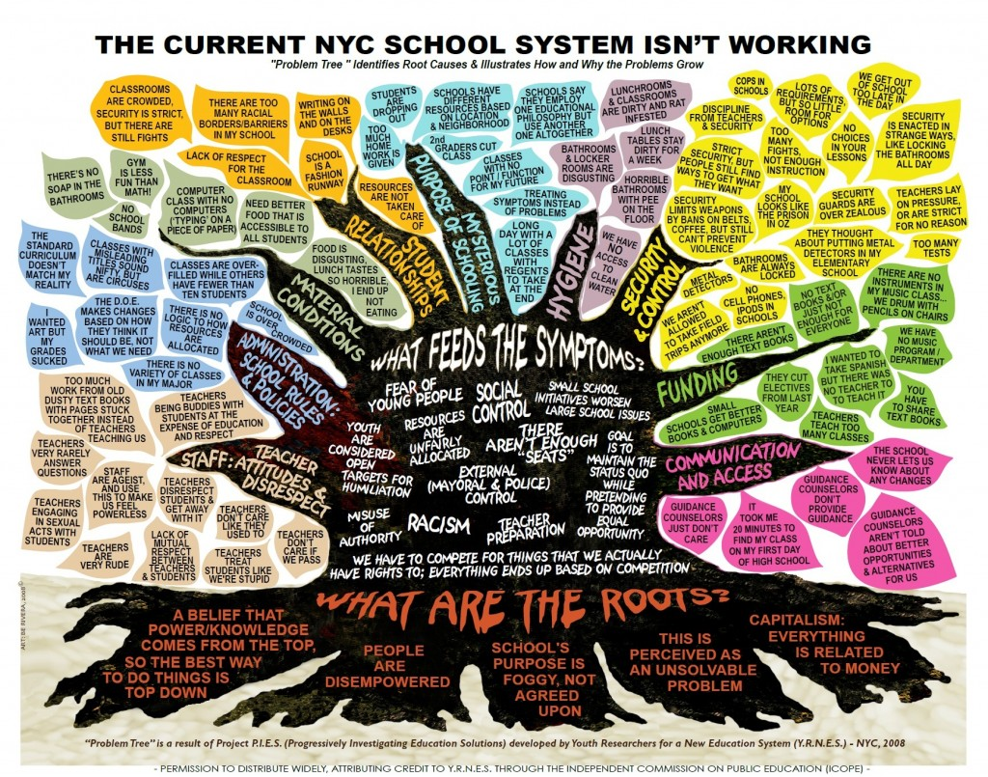

Slide 9
Reflection
What was this experience like?
Did you find it helpful? difficult? clear?
Would you want to use this in your own research? Why or why not?

