Slide 1
Gender Studies Act-9 Ms. Lindsay
Aim: Which research methods will my group use to collect data?
Do Now (ON YOUR OWN): Write down who you want to work with (group members) & which community you want to work with
HW Due Today: Choose your community & group members
Notes:
4 mins

Slide 2
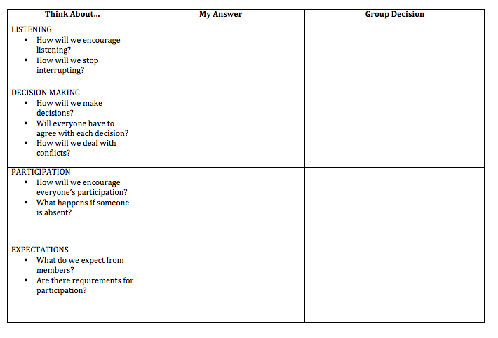
ON YOUR OWN
Fill out the “My Answer” column of the worksheet
Notes:
5 mins

Slide 3
With your group…
Fill out the “Group Decision” column of the worksheet
Notes:
6 mins

Slide 4
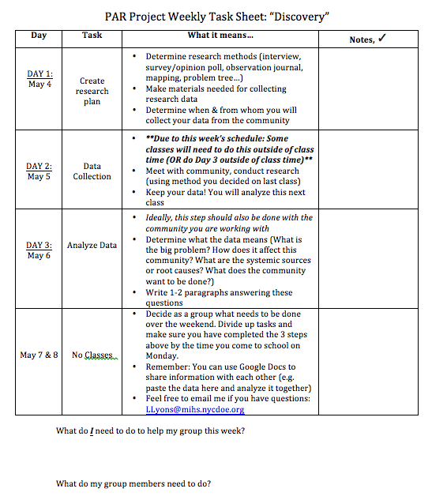
Weekly Task Sheet
Notes:
3 mins

Slide 5
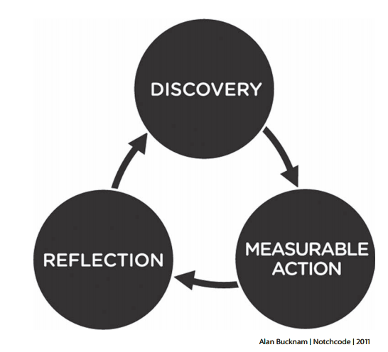
Research Methods
Interview
Survey/opinion poll
Mapping
Observation journal
Problem tree

Slide 6
Group Work
Determine research methods
interview, survey/opinion poll, observation journal, mapping, problem tree…
Collect/make materials needed for collecting research data
Determine how you will collect your data from the community
When? Which people will you talk to?
Notes:
45 mins

Slide 7
Share Out
What went well?
What did you decide?
How are you dividing up the tasks?
Any questions?
Notes:
2 mins

