Slide 1
Gender Studies Fem-14 Ms. Lindsay
Aim: How can we develop an interesting, specific, & realistic research question?
Do Now (ON YOUR OWN): Fill out the student survey online. Follow the directions on your card.
HW Due Today: Police essay (if you have not already given it to me)

Slide 2
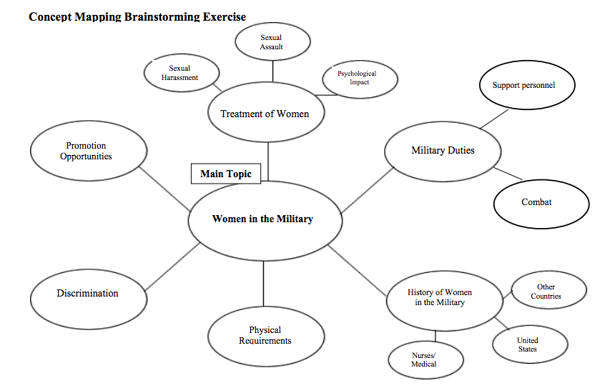

Slide 3
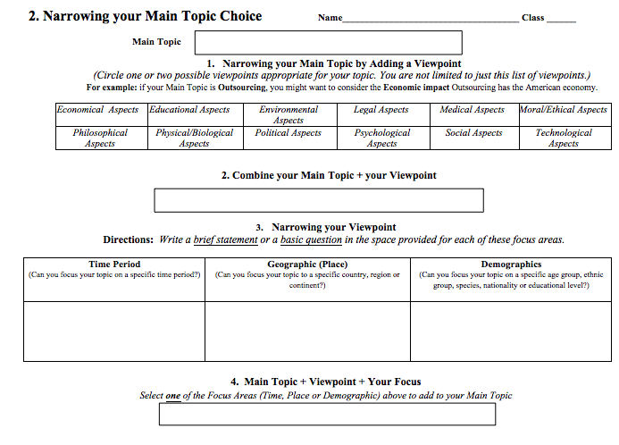

Slide 4
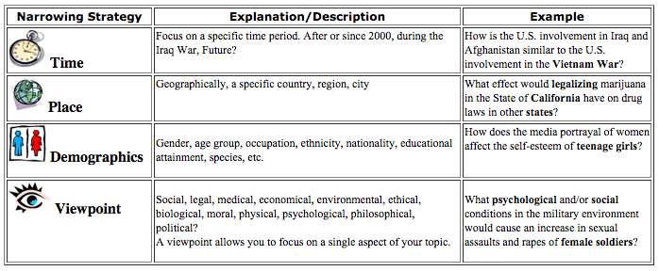

Slide 5
Looking at causes, effects, solutions
CAUSES: Why has the number of sexual assaults and harassment cases towards female soldiers increased in the various branches of military service?
EFFECTS: How has the treatment of female soldiers by their male comrades affected women’s interest in serving in the military?
SOLUTIONS: What are the different branches of military service doing to address the problem of sexual assault against female soldiers by their male comrades?
SOLUTIONS: What practices or training techniques could the U.S. military employ that would help prevent or deter the abusive behavior by male soldiers towards their female comrades?
Notes:
*We are focusing on activist strategies, so solutions or attempts at solutions are our focus for this research. Make sure your question focuses on this topic in some way.

Slide 6
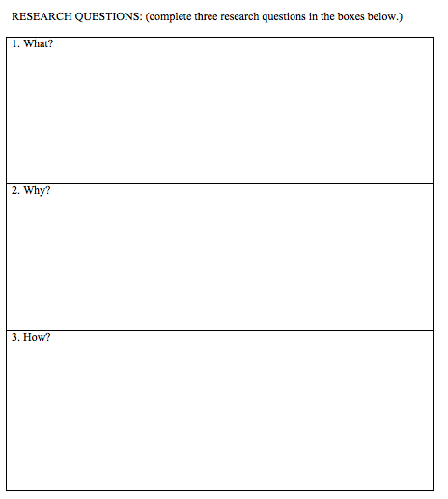
Sentence Starters
Which strategies were most effective….?

Slide 7
Broad Topic:
Narrow it Down:
Research Question:
1
Sports
2
How did women gain equality in sports?
3
Which strategies were most effective in creating a WNBA league?
Notes:
MODEL

Slide 8
More Examples
TOO BROAD
STRONG!
How does trash pollute the environment?
How does divorce affect our society?
Is alcohol harmful to young people?
What is the environmental impact of plastic water bottles?
How does divorce influence children’s social development?
Does drinking alcohol in college impact a student’s GPA?
Notes:
REMEMBER TO LOOK AT THIS SHEET FOR MORE EXAMPLES…
From: http://libguides.lmu.edu/content.php?pid=10084&sid=1965230

Slide 9
Which research question is the strongest?
Question A: Do children sent to day care or preschool start kindergarten with more developed skills?
Question B: Do children sent to day care or preschool start kindergarten with more highly developed language skills?
Question C: Do children sent to day care or preschool start kindergarten with larger vocabularies?
Notes:
B (A too broad, C might not have enough info)

