Slide 1
Gender Studies Fem-15 Ms. Lindsay
Aim: How can we create a strong, analytical research paper?
Do Now (IN YOUR GROUP): Domino Share your homework answers. What parts do you need in a research paper? Make a list, writing each part in the order you think makes sense.
HW Due Today: Police essay (LAST day)

Slide 2
BRAINSTORM: Parts of a Research Paper
Notes:
: Find facts/evidence -
Works cited page (sources)
5 W’s – explain
Pictures
Primary sources
Cause & effect
Solutions
Opinions – different points of view
D: Setting/background (time, problem)
Research question
Works cited
Interview (form of research)
A:
Research Question
Group of people you’re researching
Evidence/facts
Topic – main idea (problem, definition)
SPECIFIC: Social groups/identity, geography
Sources – Works Cited
effects/impact
Timeline/dates/setting
5 W’s
C:
Citations
Evidence – dates
General Topic
Analyze – connections
Research Question
Title

Slide 3
Typical Research Paper Format
Section 1—Introduce and explain topic.
Section 2—Discuss history, background; set the context.
Section 3—Discuss research methods.
Section 4—Discuss research findings.
Section 5—Conclusions
Works Cited

Slide 4
Types of research papers
Review of the literature in a field
Analysis
Argument
Essay
*Analytical research projects tend to ANSWER a research question rather than DEFEND a stance

Slide 5
To analyze…
break a topic down into parts
get a DEEP understanding
represent the parts in a NEW WAY (from your own point of view)
Example: role of the mother in the ancient Egyptian family
Break it down: mother's duties in the family, social status, expected role in the larger society
Research
Present information from your point of view (your conclusion about the mother's role)

Slide 6
CLASS B: OUR ANALYTICAL PAPER OUTLINE
Introduction – introduce topic (definition, history – start, what has changed?), research question [LAST sentence]
Body 1 - Evidence (quotes & paraphrasing – statistics, graphs, different people, )
LAST Body – Solutions (FACTS)
Conclusion – YOUR point of view (why it is important?)
Works Cited
PICTURES – graphs, people, symbols…

Slide 7
CLASS C: OUR OUTLINE
Introduction – hook, background facts, definition, explanation of topic, research question
Body – EVIDENCE (answers to our question)
2-3 paragraphs
LAST BODY: SOLUTIONS [RESEARCH]
Conclusion – Summarize, Point of View, Connections – Suggested solutions

Slide 8
CLASS A: OUR OUTLINE
Introduction: hook, background (definition, quick facts), research question
Body: topic sentence, JUST EVIDENCE
Compare: 2
Causes/treatment: 2-3
LAST Body: SOLUTIONS (RESEARCH)
Conclusion: analysis + YOUR SUGGESTED SOLUTIONS

Slide 9
CLASS D: OUR OUTLINE
Introduction – hook, background (timeline), definition, LAST SENTENCE: research question
Body (1-3) – EVIDENCE cause
LAST BODY: SOLUTIONS [RESEARCH]
Conclusion – SHORT summary (answers the research question), connections (to class, to today, why it’s important), POINT OF VIEW – suggest more solutions

Slide 10
What search terms will you use to find information online?

Slide 11
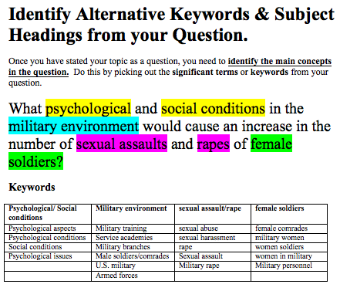

Slide 12
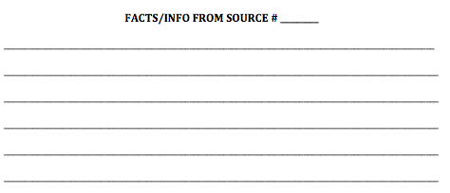
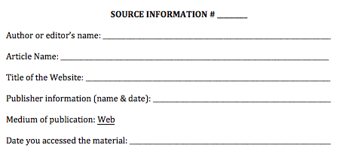
Taking Notes

