Slide 1
Gender Studies Fem-1 Ms. Lindsay
Aim: How have women in history fought for equal rights?
Do Now (ON YOUR OWN): Go to this website:
https://app.jumpro.pe/student/MIHS
HW Due Today: Lesson reflections (what went well, what would you change) & partner grades for groups that presented Friday
*CLASS B: Worksheet from Thursday

Slide 2
https://app.jumpro.pe/student/MIHS
Type in your first and last name.
Ask me for your password.
Log in and look at your grades.

Slide 3
Go to: www.GMAIL.com
Username: firstname.lastname
EXAMPLE: lindsay.lyons@mihs.nycdoe.org
Password: password
Log in.
Compose email
click the red box at the top left of the screen
In “To:” type:
LLyons@mihs.nycdoe.org, LYONS.LB@gmail.com
In “Subject:” type:
IT__, LAST NAME, FIRST NAME

Slide 4
Go to: www.Coggle.it
Sign up using Google (your MIHS account)

Slide 5
How do I take notes?

Slide 6
What makes the most sense FOR ME?

Slide 7
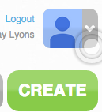
Click: CREATE
Type a title
Create the categories you want to use by clicking the + sign next to your title.
While watching the video, click the + sign next to your category to add details.

Slide 8
MAKERS: WOMEN WHO MAKE AMERICA Part One: Awakening

Slide 9
Lots of episodes on PBS!

Slide 10
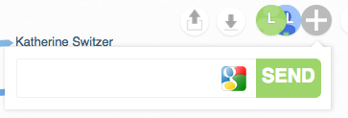
DAY 2
When finished…
Click the + sign at the top right of the screen
Type in my email address to share with me:
LLyons@mihs.nycdoe.org
Click SEND

