Slide 1
Gender Studies GI-20 Ms. Lindsay
Aim: How do we write our conclusion & cite our sources?
Do Now: Open your Google Doc
HW Due Today: Introduction and Body Paragraphs

Slide 2
How do I write my conclusion?
In conclusion, REPEAT TOPIC is an issue.
Based on the above research, THIS IS WHERE YOU MAKE YOUR CONNECTIONS – LOTS OF ANALYSIS….
It can be concluded THESIS (answer your research question in one sentence).

Slide 3
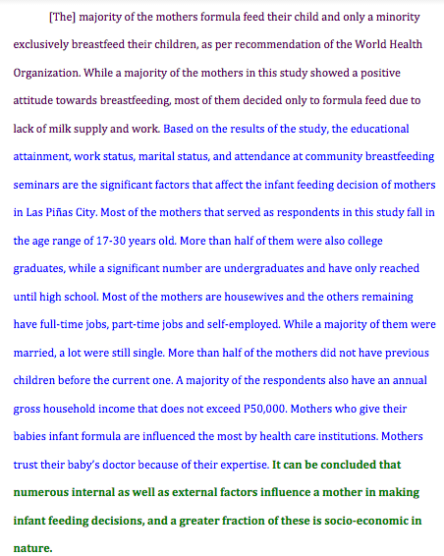
Example of Conclusion
Notes:
Excerpted & slightly adapted from: Explorable.com (Jun 26, 2009). Research Paper Example. Retrieved Mar 24, 2015 from Explorable.com: https://explorable.com/research-paper-example
Parts to Notice:
Repeat problem – what you are studying
Synthesize* research findings – this research focused on what affects women’s choice to breastfeed (list them here – no new information here)
***MISSING (you will write this after summarizing & before thesis): Solutions – suggest more solutions – what needs to happen next
Thesis – answer your research question in one sentence
*Synthesize, don’t summarize: Include a brief summary of the paper’s main points, but don’t simply repeat things that were in your paper. Instead, show your reader how the points you made and the support and examples you used fit together.

Slide 4
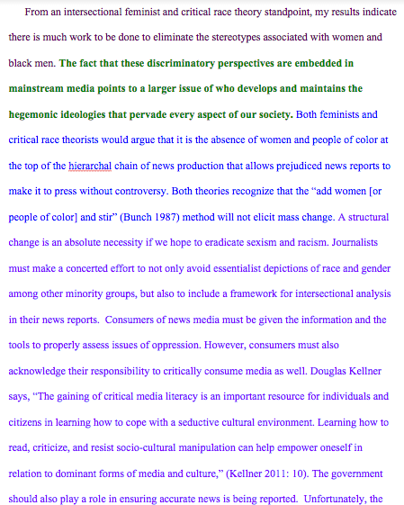
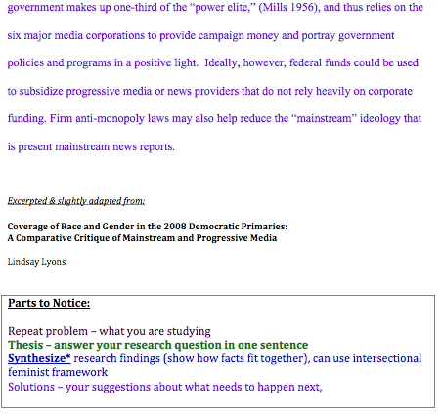
2nd Example of Conclusion
Notes:
FOR FULL MORE OR A LARGER FORMAT, GO TO: https://docs.google.com/document/d/1v87bsO01AccMTCGtyP03WP-pjgodHcYh5DGcgn8mU-g/edit?usp=sharing

Slide 5
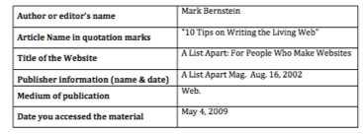
Now, the citations! First, let’s make a Works Cited page.
Take out your note cards OR go to your Google Doc (if you just pasted the links there)

Slide 6
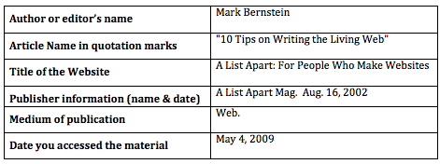
Bernstein, Mark. "10 Tips on Writing the Living Web." A List Apart: For People Who Make Websites. A List Apart Mag., 16 Aug. 2002. Web. 4 May 2009.

Slide 7
easybib.com

Slide 8
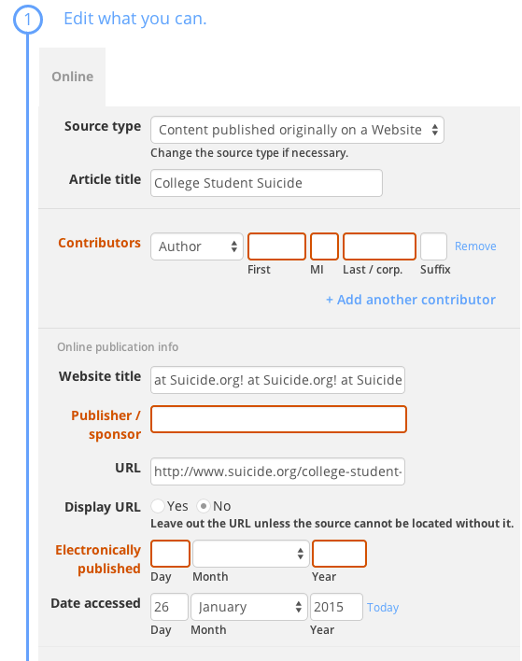
*Make sure you fill in all the boxes if they are not already filled in!

Slide 9
In-Text Citations – Replacing the #s
Take the FIRST term from each source (last name, company name if no author, 2 last names if 2 authors
The Economist. “The Conundrum of the Glass Ceiling.” Crisis in American Institutions. Boston: Ed. 13. 2007. 158-164.
Elliott, Michael. "THE NEW GLOBAL OPPORTUNITY." Fortune 162.1 (2010): 96-102. Academic Search Complete. EBSCO. Web. 13 Nov. 2010.
Herz, Barbara & Gene B. Sperling. What Works in Girls' Education: Evidence and Policies from the Developing World. New York: 2004.

Slide 10
In your paper, it will look like…
When young women are provided with microloans, they are seen as economically beneficial to their families. As a result, these women are less likely to be forced into marriage at a young age (Elliot).
According to a graph from March 2004, Norway boasted the highest percentage of female CEOs at 22%. The same graph puts the US at 13% (The Economist).
Other outcomes of properly educating women include: decreases in family size, child mortality, chance of contracting HIV, rates of domestic violence, and an increase in levels of democratic participation (Herz and Sperling).

