Slide 1
Gender Studies Fem-22 Ms. Lindsay
Aim: How can we learn from our peers?
Do Now (ON YOUR OWN): What did you like about this project? What did you dislike (or what was really hard?)
HW Due Today: Analytical Research Papers (finished on Google Docs) & magazine article

Slide 2
Group Share: 8-10 minutes per paper
4 mins: 1st presenter reads paper out loud
Listeners can highlight
1 min: Listeners domino share “I liked…”
1 min: Q & A
How did you…?
Why did you choose…?
2 mins: Fill out graphic organizer

Slide 3
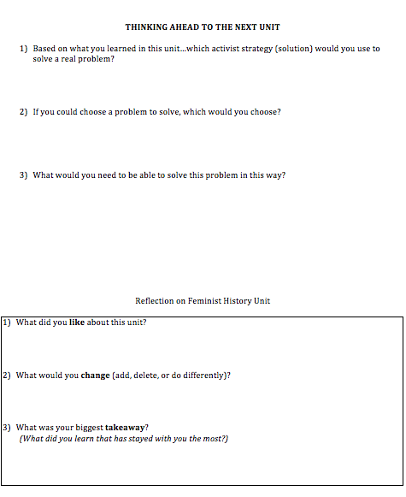
ON THE BACK
Fill out your reflection sheet!
The last set of questions is about the unit as a whole (since the Makers video)

