Slide 1
Gender Studies Fem-3 Ms. Lindsay
Aim: How has the feminist movement gained rights for women?
Do Now (ON YOUR OWN): How do you decide what is the MOST IMPORTANT information in a text?
HW Due Today: Take out your notes from the movie & have them on your desk
Notes:
Share your Coggle with me

Slide 2
Domino Share: How do you decide what is the MOST important information in a text?
Each group pick a person to share first.
Raise your hand if you are going first.
Go in a circle. Everyone shares an answer.
Choose a reporter to share 1 idea your group talked about.
Reporters raise your hands.

Slide 3
IN YOUR GROUP: Read the timeline in front of you
DISCUSS:
Which events are most important?
Why is this event important?
(What happened IN OUR OWN WORDS?)
*Hint: If one event is on BOTH timelines, it’s probably pretty important.

Slide 4
FOR EACH EVENT…
Make a poster with:
A title
The date
Summary of what happened in ONLY A FEW WORDS
Important people (if any)
Define any important vocabulary
Only define vocabulary if you can’t use another word to explain what it means

Slide 5
Example Poster
Aug. 28, 1963
March on Washington
200,000+ people marched for freedom & economic equality* for Black Americans
Dr. Martin Luther King Jr. – “I Have a Dream” speech
*economic equality: equal pay for equal jobs

Slide 6
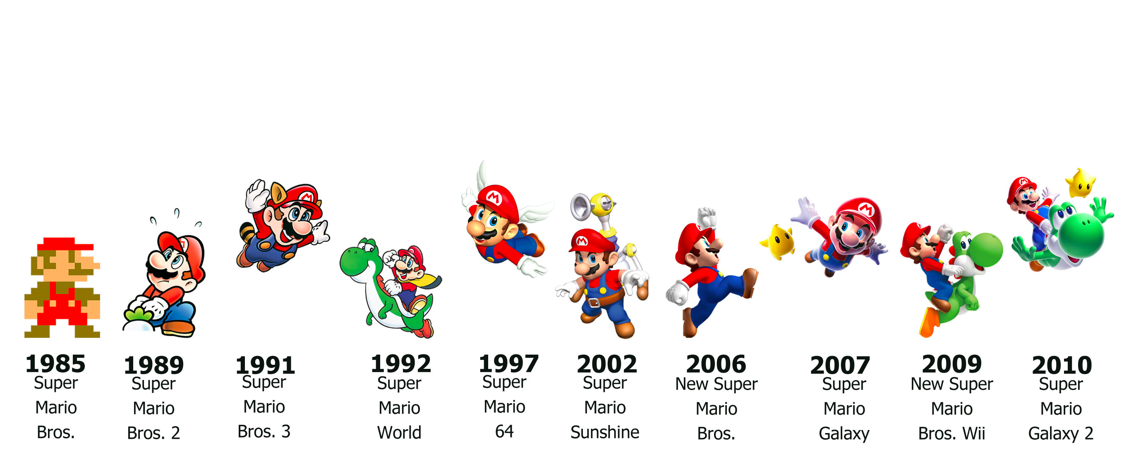
Chronological Order
Anyone with a poster will bring the poster SILENTLY into the hallway & line up against the wall.
Anyone without a poster will SILENTLY help arrange the students in order to form a human timeline.
Notes:
Teacher numbers the events

Slide 7
Gallery Walk
Take your timelines.
Everyone will start at a different numbered event.
Write the date & most important information on your timeline worksheet.
Move around the room in chronological order (clockwise).

Slide 8
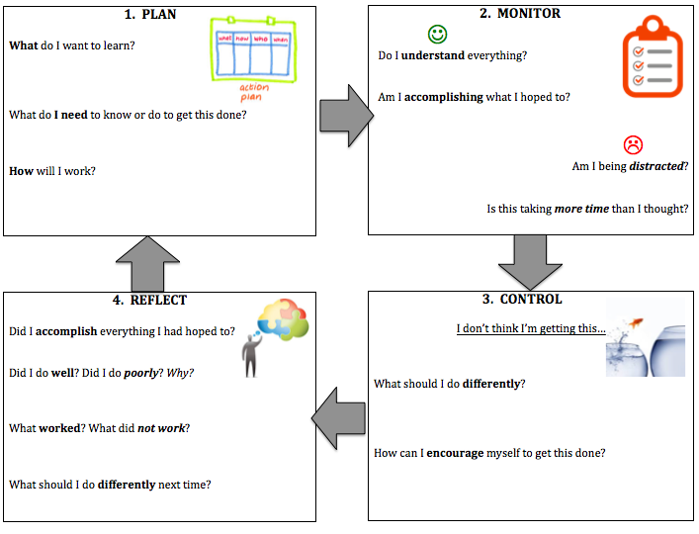

Slide 9
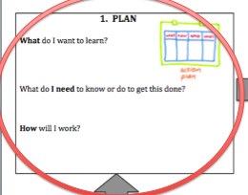
PICK YOUR OWN HOMEWORK!
What more do you want to learn?
How can you learn this?

Slide 10
EXAMPLES
I want to know more about…
So, I am going to find this information in a …
News article
Opinion piece
Video
Wikipedia
Then, I am going to…
Write a summary
Make a poster
Record a video of myself reporting on what I found
Write a poem from the point of view of the person I researched

