Slide 1
Gender Studies Fem-4 Ms. Lindsay
Aim: How did the women’s movement begin?
Do Now (ON YOUR OWN): Read through the timeline. Highlight what YOU THINK are the 3 most important events.
HW Due Today: Send me an e-mail from your MIHS account
Notes:
Share your Coggle with me

Slide 2
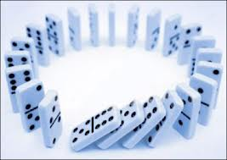
DOMINO SHARE
What events did you choose?
Why?

Slide 3
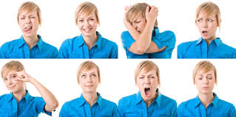
VOCABULARY
sentiments –
disenfranchise –
Notes:
Sentiments – feelings
Disenfranchise – take away power, e.g. not allowed to vote

Slide 4
Women’s Suffrage
WHO:
WHAT:
WHERE:
WHEN:
WHY:
HOW:
Lucretia Mott, Elizabeth Cady Stanton, Susan B. Anthony
movement to get women the right to vote
Seneca Falls, NY (famous meeting)
1848-1920
equality
19th Amendment

Slide 5
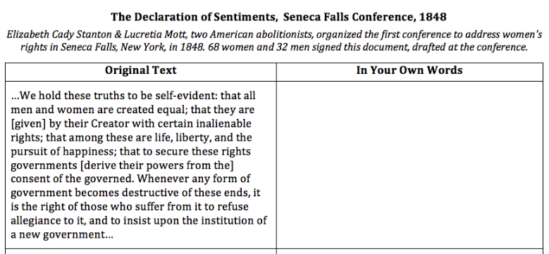
Notes:
Everyone has the right to be free → language is the same as Declaration of Independence in 1776 (US broke free from England)

Slide 6
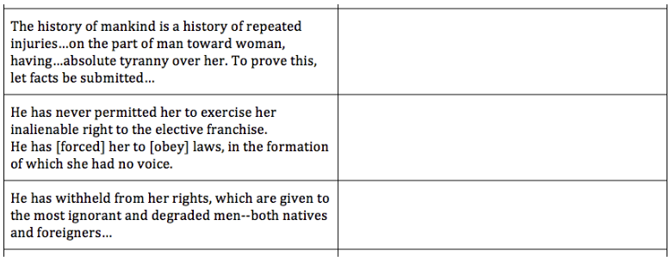
.
.
.
Notes:
Men have mistreated women through generations & here is proof; men have always made women suffer, have power over them
women have no right to vote; men take right to vote from women
women have not had rights, other groups do; women think their rights are being given to “useless” people

Slide 7
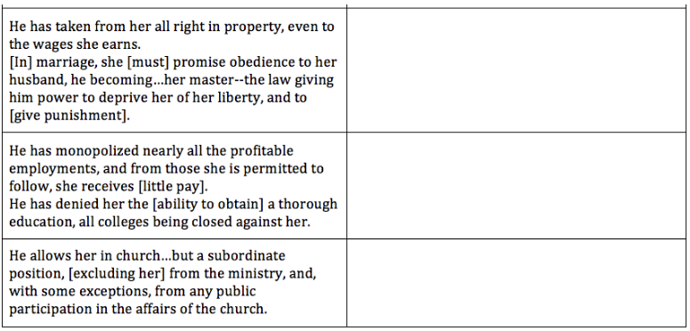
.
.
.
Notes:
husband is king & she must obey, money & property goes to husband; after marriage, women are husband’s property
same work, less pay, can’t go to college; men get good jobs, women get paid less, women can’t go to college
can’t participate in all events in church; women seen as weaker in church, can’t fully participate in public or be leaders

Slide 8
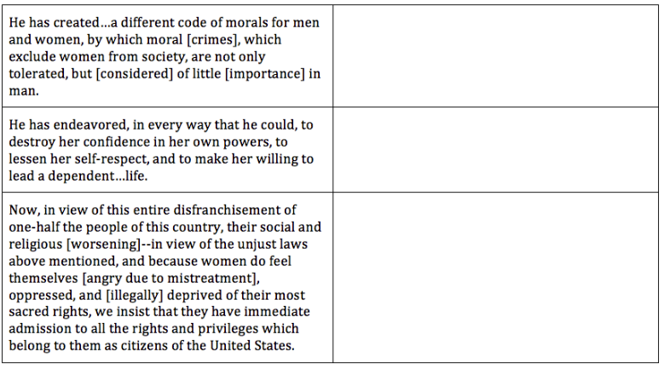
.
.
.
Notes:
men created rules to make women unequal; women seem less important than men
men destroy women’s confidence; men bring women down & make them feel bad about themselves
women are angry & demanding equal privileges; women cannot vote & they want the US to give them rights

Slide 11
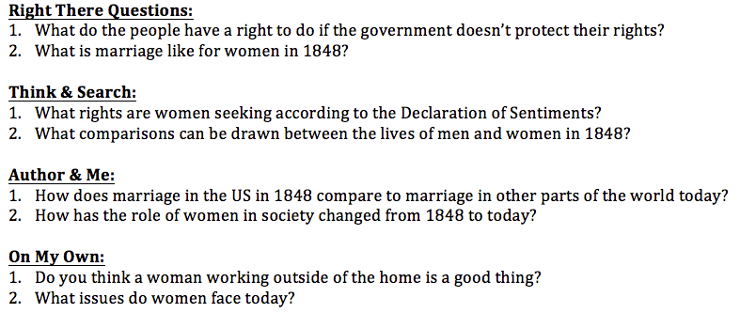
HOMEWORK
Why is gender equality important?
Have the problems listed in the Declaration of Sentiments been solved?
Notes:
Have students change the last 2 questions (on my own)

Slide 12
If you are interested…

