Slide 1
Gender Studies Fem-9 Ms. Lindsay
Aim: How can we apply make a difficult text more understandable?
Do Now (ON YOUR OWN): Name one strategy you use when a text is difficult to understand.
HW Due Today: Seminar sheet & movie notes (if you have not already shown me)

Slide 2
STRATEGY BRAINSTORM
Paraphrase in chunks
Underline, then paraphrase
Re-read
Translate
Circle word – context

Slide 3
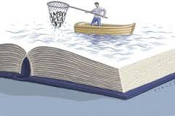
Why would we re-read a text?
Determine which strategy works best for you
The goal is for you to apply strategies on your own!
The more you read, the more you get out of it
Academics re-read several times for different purposes
Notes:
Like when you watch a movie again, you notice things you may not have noticed before

Slide 4
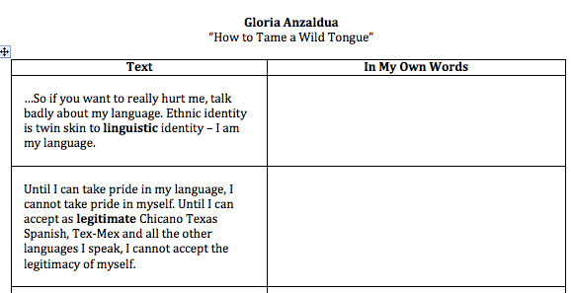

Slide 5
As a group…
Paraphrase (put in your own words)
18 mins
Write the main idea
2 mins

Slide 6
Before we share out…
ON YOUR OWN: Highlight the sections you DO understand & can explain to someone else

Slide 7
Setting up Group Shares
1. Count off by 5’s in your group
2. Go to the table assigned to your number. (There should be at least one of each number in every group.)
3. Choose a person to go first. Raise your hand if you are going first.

Slide 8
Group Share Process
Presenter: Share main idea & other interesting thoughts your group had 2 mins
Listeners: Ask questions, add thoughts 3 mins

Slide 9
Feminist | Main Idea
Audre Lorde | Women should fight for rights, use knowledge to get out of men’s dominance
Kimberle Crenshaw | All women of color & immigrants should be treated equally by movements (feminism, antiracism)
Angela Davis | Drug-using women are criminalized & seen as bad wives/mothers (jailed)
Patricia Hill Collins | LGBT & different groups of women should have a place to show different interests
Chandra Mohanty | Veiled women – some forced, some are acts of revolution
Notes:
Class B

Slide 10
Feminist | Main Idea
Notes:
Class B

Slide 11
Reflection Question
Which feminist’s ideas do you find most interesting? Why?

