Slide 1
Gendered Violence
Gender Studies
Ms. Lyons

Slide 2
Gender Studies Nov. 6, 2013
Learning Intention: We will identify the features of abuse and apply these terms to our understanding of relationships.
Success Criteria:
3 phases of the cycle of abuse
2 types of abuse
1 solution to gendered violence
Do Now: What questions or thoughts do you have after watching the SVU episode Monday?

Slide 3
Gendered Violence includes
Intimate Partner Violence
Domestic Violence
In the home: parent/child
Perpetrated by Acquaintance or Stranger
93% of juvenile sexual assault victims know their attacker
Females are usually the victim

Slide 4
Why this term?
Shift the focus from women as victims
Emphasize unequal power relationships
Created/maintained by gender stereotypes
Movies, song lyrics, ads…
Notes:
Vs. “Violence against women”

Slide 5
5 Types of Gendered Violence
Physical
Sexual
Verbal
Psychological
Socio-economic

Slide 6
Physical Abuse
Beating, kicking, punching, biting
Female Genital Mutilation
Honor Killings
Female infanticide
Forced/coerced sterilization

Slide 7
Sexual Abuse
Rape
Forced to have unsafe sex
Sexual harassment
Prostitution
Forced/coerced pregnancy/abortion
Withdrawal of sexual attention

Slide 8
Verbal Abuse
Regular & systematic verbal attacks
Put-downs
Humiliating
Threatening
Name-calling

Slide 9
Psychological Abuse
Intimidation
Force to watch animal/human being hurt
Deprivation of custody/visitation of kids
Cupboards story

Slide 10
Socio-economic Abuse
Taking away earning of victim
Not allowing victim to get a job
Isolation from friends, family, everyone
Lack of child care support
Used to make victims more vulnerable to other forms of violence

Slide 11
CEDAW
Convention on the Elimination of All Forms of Discrimination against Women
International Bill of Rights for Women
USA is one of 8 countries that has not ratified CEDAW
Others include: Iran, Somalia, Sudan

Slide 12
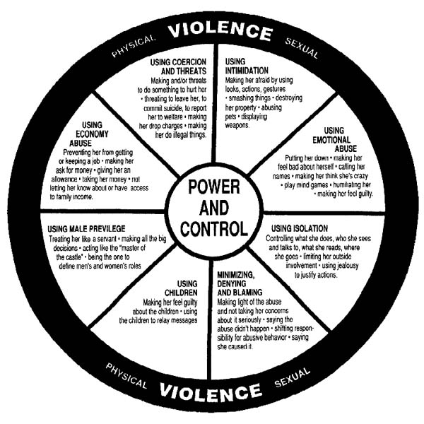

Slide 13
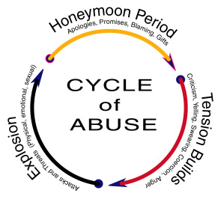

Slide 14
What Can We Do?
Education – raise awareness
Legislation (laws)
Violence Prevention
National committees focused on gender issues
Gender equality in all aspects of life
Affirmative Action
Let girls & women’s voices be heard.

