Slide 1
Gender Studies GI-3 Ms. Lindsay
Aim: How can we take effective research notes?
Do Now (ON YOUR OWN): What do you think your group’s first step will be?
HW Due Today: None

Slide 2
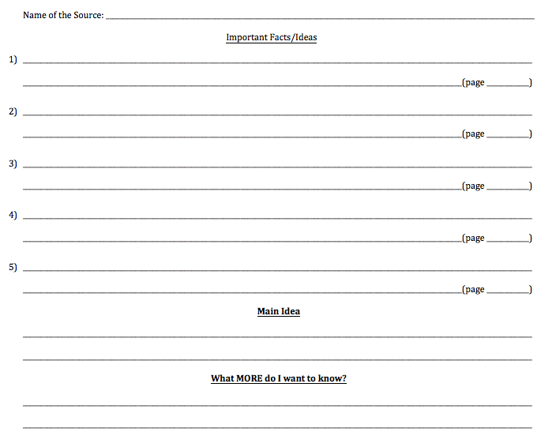

Slide 3
ANNOTATING
Underline/Highlight what is IMPORTANT
Star the MAIN IDEA (or pieces of it)
Question mark CONFUSING words or things you want to KNOW MORE about

Slide 4
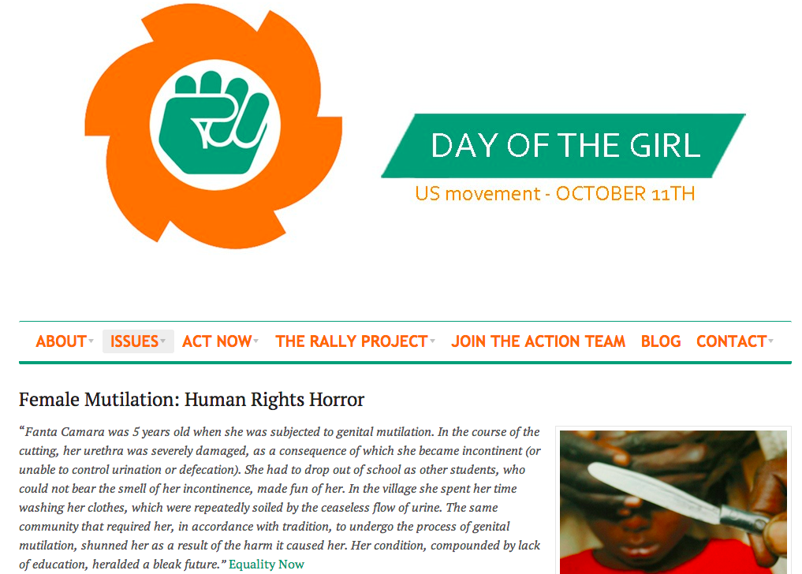

Slide 5
MODEL
FGM stands for…Female Genital Mutilation, also known as female circumcision or genital cutting. FGM involves the surgical removal of parts of the external sensitive female organs; in its most extreme form, almost two-thirds of the external genitals are removed, followed by stitching up, leaving only a small hole for urination and menstruation.
Globally, it is estimated that between 100 and 140 million girls and women have experienced some form of FGM, and that every year about three million girls, most younger than 12, are at risk of undergoing this dangerous procedure.
FGM is common throughout many countries in Africa, and in Indonesia, Malaysia, Yemen, Oman, United Arab Emirates, India, and Pakistan. Somalia has one of the highest rates where 97.9% of females have undergone FGM. It also occurs in some immigrant populations in America, Australia, New Zealand, Canada and some European countries.
Brigham Hospital for Women in Boston estimated that 227,887 girls and women in the United States in the year 2000 were at risk of being subjected to FGM.

Slide 6
ANNOTATING
Underline/Highlight what is IMPORTANT
Star the MAIN IDEA (or pieces of it)
Question mark CONFUSING words or things you want to KNOW MORE about
In Somalia, 98% of females have had FGM
Millions of girls are at risk – dangerous*
genitals?
Common in many countries in Africa ?

Slide 7
Name of the Source: _______________________________________________________________ Important Facts/Ideas 1) ____________________________________________________________________ ____________________________________________________(page ____________) 2) ____________________________________________________________________ _____________________________________________________(page ____________) Main Idea ____________________________________________________________________________________________________________________________________________ What MORE do I want to know? ____________________________________________________________________________________________________________________________________________

Slide 8
Group Work
Read independently OR as a group.
*Make sure everyone is able to read & understand.
Annotate INDEPENDENTLY.

Slide 9
Think – Talk – Open Exchange
PARTNER 1:
Think
Talk
PARTNER 2:
Think
Talk
PARTNER 3:
Think
Talk
Open
Exchange
Notes:
FOR MAIN IDEA

Slide 10
HOMEWORK
Cite the book from which you took notes today. (Follow the example on the back of your worksheet.)
THINK ABOUT the following questions:
1) Why is it important to cite your work properly
2) What are the consequences if you do not cite your work properly?

