Slide 1
Gender Studies GI-6 Ms. Lindsay
Aim: What more information do we need to find before creating our lesson?
Do Now (ON YOUR OWN): What is the MOST IMPORTANT idea or fact you need to teach to the class?
HW Due Today: AT LEAST 2 internet sources & 1 book source (both sides of the sheet, including source information!)

Slide 2
Think – Talk – Open Exchange
PARTNER 1:
Think
Talk
PARTNER 2:
Think
Talk
PARTNER 3:
Think
Talk
Open
Exchange

Slide 3
CREATE AN OUTLINE
Choose 1 writer
Write down BIG ideas (categories) of what you want to teach
Put them in order (what should you teach at the beginning of the lesson? at the end?)

Slide 4
MODEL OUTLINE
Define FGM
Facts – where? how common is it?
Why?
What are the effects on the girls?
What is the solution?

Slide 5
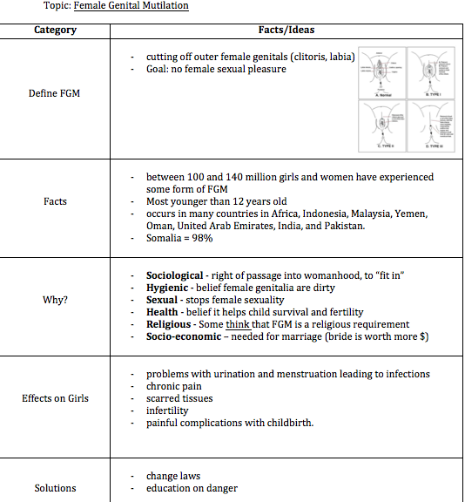

Slide 6
What are you missing?
Can you define your topic?
Do you have facts about your topic? (where this happens, how often it happens)
Can you explain why your topic is an issue?
What effect does it have on victims/people
Is there a solution?

Slide 7
Divide up your tasks

