Slide 1
Gender Studies GI-7 Ms. Lindsay
Aim: How can we teach the class for one hour?
Do Now: Take out the outline your group created yesterday.
HW Due Today: AT LEAST 3 internet sources & 1 book source (both sides of the sheet, including source information!)

Slide 2
What’s in a lesson?
Objective
what you want the class to learn
Essential Question
must use critical thinking to answer (no 1 answer)
usually starts with “How” or “Why”

Slide 3
Essential Questions MODELS
NOT “ESSENTIAL”
VERY STRONG!
Where does FGM occur?
Are boys or girls victims of FGM?
What is being done to solve this problem?
How has FGM affected girls in Africa?
How do gender roles affect the practice of FGM?
Why has this problem been difficult to solve?

Slide 4
What’s in a lesson?
Objective
what you want the class to learn
Essential Question
must use critical thinking to answer (no 1 answer)
usually starts with “How” or “Why”
Activity
how you will get the information to the class

Slide 5
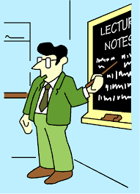
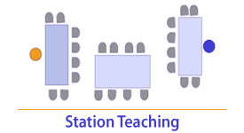
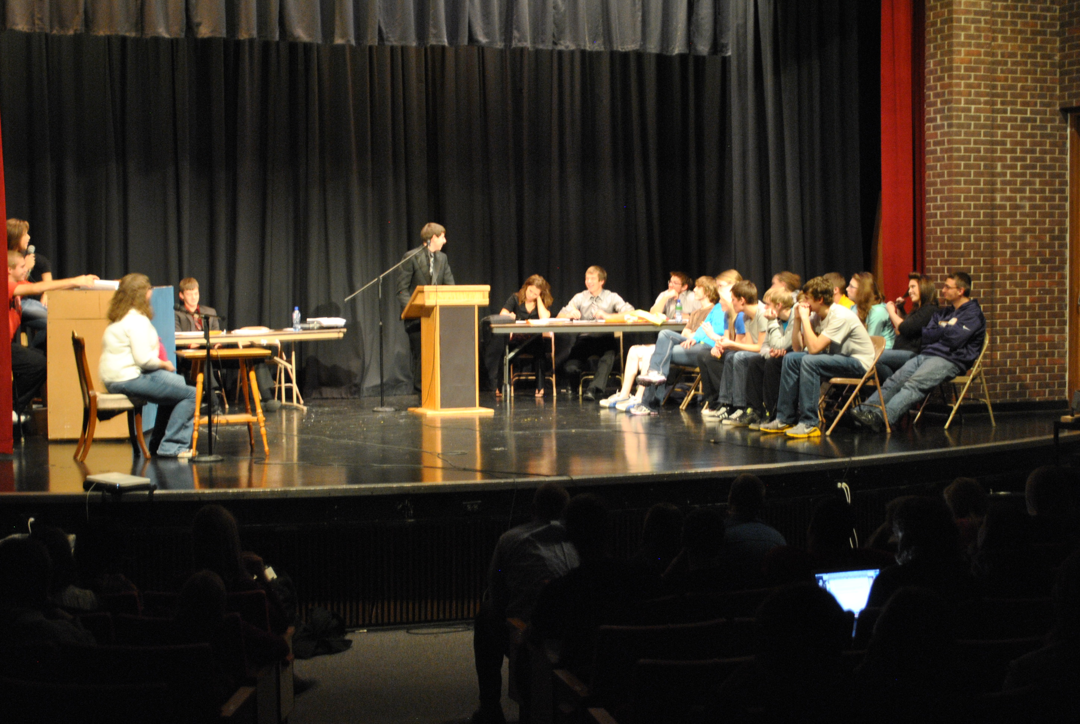
Activities
Interactive lecture
Stations/Gallery walk/Write-around
Jigsaw
Simulation

Slide 6
What’s in a lesson?
Objective
what you want the class to learn
Essential Question
must use critical thinking to answer (no 1 answer)
usually starts with “How” or “Why”
Activity
how you will get the information to the class
Assessment
how you will know the class learned what you taught

Slide 7
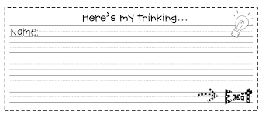
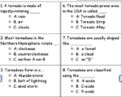
Assessments
Students answer essential question (exit slip)
Multiple choice quiz
Mini seminar
Mini project/poster

Slide 8
Fill in the boxes on your worksheet AS A GROUP

Slide 9
Think – Talk – Open Exchange
PARTNER 1:
Think
Talk
PARTNER 2:
Think
Talk
PARTNER 3:
Think
Talk
Open
Exchange
Notes:
Groups - use this routine to ensure all ideas are heard

Slide 10
What do we do next?
Make a list of what needs to be done
Decide which person is finishing each task

