Slide 1
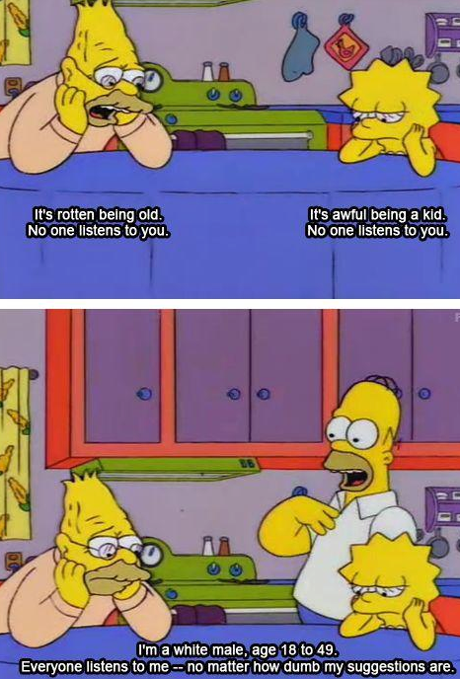

Slide 2
Gender Studies ID-10 Ms. Lindsay
Aim: How do different nationalities experience our society?
Do Now: Look the image on your table.
Discuss as a group & determine the main idea.
Do you agree or disagree? Explain.
HW Due Today: None

Slide 3
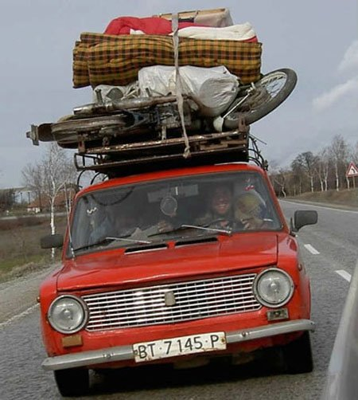
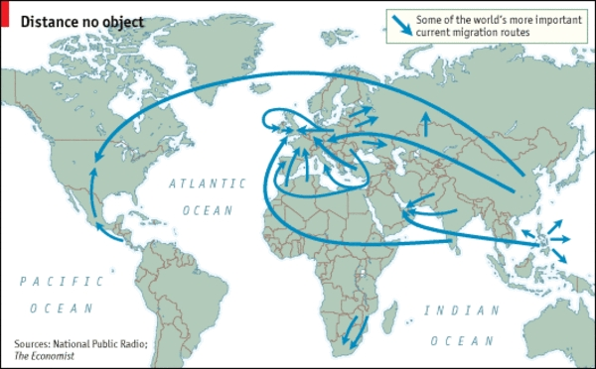
VOCABULARY
Nationality –
Migration –
Notes:
the country you born in/have citizenship in
moving to another place permanently (to live)

Slide 4
Share Your Experience
How is life in your home country different than the US?
What was the migration experience like?

Slide 5
Writing Piece – Due ID-13 [Thursday for B; Friday for A, C, D]
Task: Write a poem/story that reflects your identity (gender, race, nationality)
Outcomes
Student voice, Conventions, Connections
Activities:
Look at models
Peer/family interviews
Conventions lesson

Slide 6
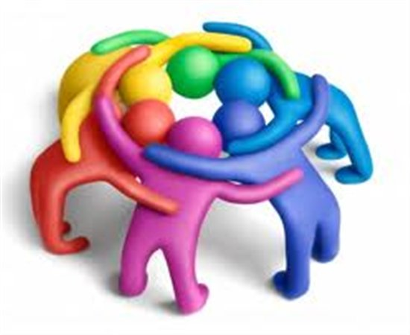
Look at Models
Read each model as a group.
Highlight/underline what you LIKE
Discuss as a group & be ready to share out

Slide 7
What we LIKED…
Notes:
Changing her ideas
Repetition (counting) – EMOTION
Description – actions, people – feelings, scenery
“the personal is political”
Video – w/voice, poem written
Migration
Rhythm – list, short phrases
Experience/memory
Emotion – of hers, of family’s, of reader’s
Makes you feel like you’re there
Native language

Slide 8
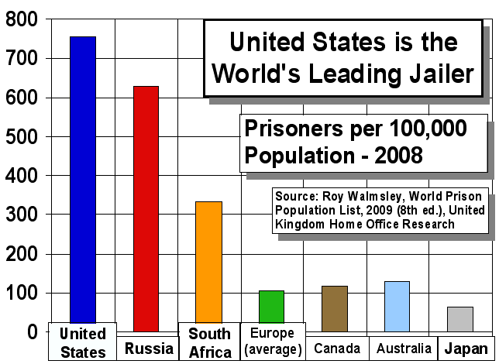
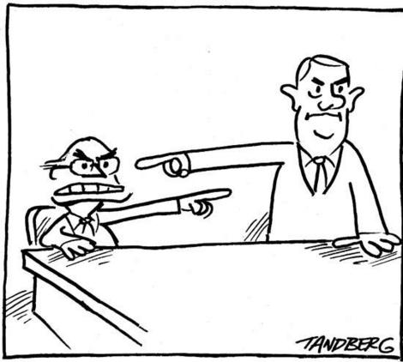
HOMEWORK Is there a connection between language and how we think and behave?

