Slide 1
Gender Studies ID-11 Ms. Lindsay
Aim: How do different genders/races/nationalities experience our society?
Do Now: Share your homework responses with your group. (What did you like about the model pieces?)
HW Due Today: List of what you LIKED about the model pieces.

Slide 2
WHAT WE LIKED…
Notes:
Specific – memory, race
“speak American” – shows racism/ethnocentrism (against other cultures)
Native language – connecting the 2, accents
Connection to world (immigration)
Rhymes
Connects positive ideas (native) contrasts life in the US
Contrast youth (☺) with hopelessness (☹)

Slide 3
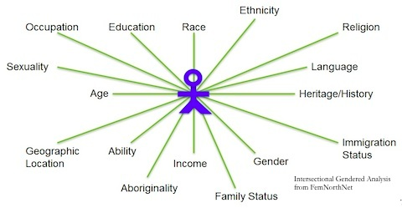
1. Pick 1 axis of identity (gender, race, or nationality)

Slide 4
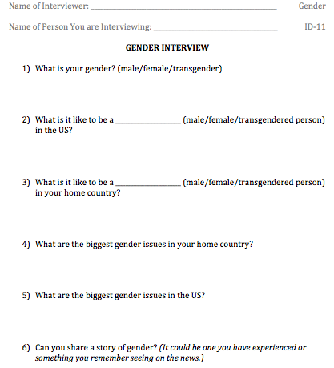
2. Get 2 pages of worksheets for JUST the axis you chose. (There will be 4 total interviews, front & back.)

Slide 5
3. Independently, YOU answer the questions on one worksheet.
I am a female
female
Women have to be…
It feels…

Slide 6
POSSIBLE RACE CATEGORIES White Black Latino Native American Asian Pacific Islander Other
Notes:
THESE ARE THE PROPOSED RACE CATEGORIES FOR THE NEXT CENSUS

Slide 7
4. Interview 2 other people about the axis of identity you chose. (Write their answers on the other 2 interview sheets.)

Slide 8
When You Have Finished All 3 Interviews…
Answer the following reflection questions
in your notebook
How were the answers the same?
How were they different?
Did the answers change by identity group?
(maybe by the amount of privilege a person has?)

Slide 9
HOMEWORK
Interview a family member
on the same axis of identity.

