Slide 1
Gender Studies ID-21 Ms. Lindsay
Aim: How can I create a piece of art that reflects my identity?
Do Now: On your own, fill in the “PREWRITING” section of your project sheet.
Homework DUE Today: Which type of art did you choose for your project?

Slide 2
Prewriting Model
ART TYPE: poem
3 medium-length poems
GENDER … FEMALE - pressure to be thin, judged more, violence against women, street harassment
RACE … WHITE – privileged, stories on news (Michael Brown, Ferguson), contrast my life with a black, teenage male’s life
RELIGION …AGNOSTIC – explain why, examples of women treated subordinate in other religions, contrast life of women in different religions/nationalities
Notes:
Red – type of art
Green – axis of identity
Blue – where YOU fall on the axis, content, ideas
Purple – vocabulary
Orange – intersectionality/connection to big issues

Slide 3
“Class” → “Yes”

Slide 4
Mirror

Slide 5
Scoreboard

Slide 6
Whole Brain Learning
“Class” – “Yes”
Mirror
Scoreboard

Slide 7
“Who Am I?” Project
Due: Oct. 29 for B & D / Oct. 30 for A & C
Artistic piece & analytical paper
MAKE DEEP CONNECTIONS
personal life
big issues
vocabulary
Be creative!

Slide 8
“Teach” → “Okay”

Slide 9
HOW LONG DOES IT HAVE TO BE?
Artistic poems must total 400 words.
four 100-word poems OR
one 400-word poem
Written analysis must be 500 words.

Slide 10
“Teach” → “Okay”

Slide 11
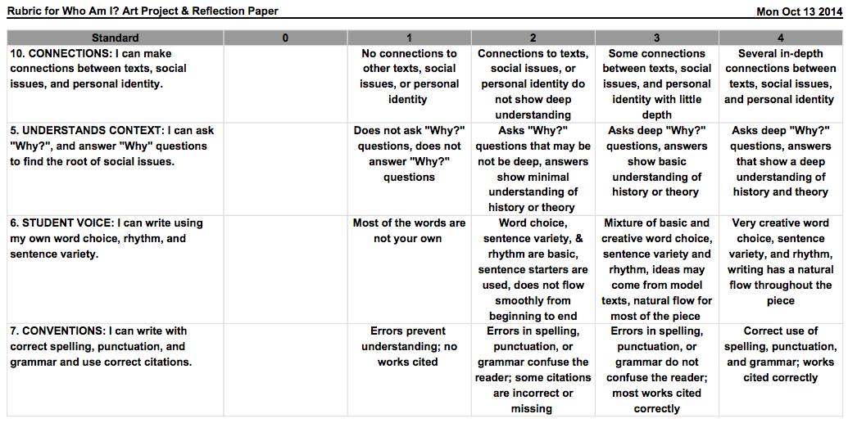

Slide 12
“Teach” → “Okay”

Slide 13
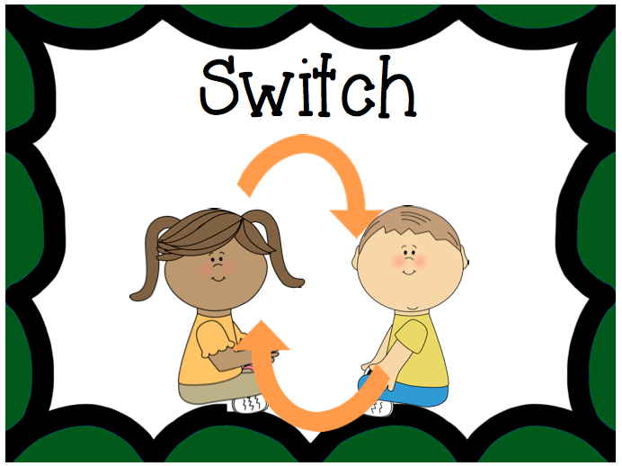
Whole Brain Learning
“Class” – “Yes”
Mirror
Scoreboard
“Teach” – “Okay”

Slide 14
Questions?

Slide 15
In a minute… move to the table of your art type.
TABLE 1: poetry (including slam poetry)
TABLE 2: movie
TABLE 3: collage (with pictures)
TABLE 4: drawing or painting
TABLE 5: song or dance

Slide 16
What do you need to keep going?
“Before you share…” → “Put ‘em in the air!”

Slide 17
Whole Brain Learning
“Class” – “Yes”
“Before you share” – “Put ‘em in the air”
Mirror
Scoreboard
“Teach” – “Okay”

Slide 18
TODAY: Drafting

Slide 19
Whole Brain Teacher step to add later if needed…

Slide 20
“Hands & Eyes”

Slide 21
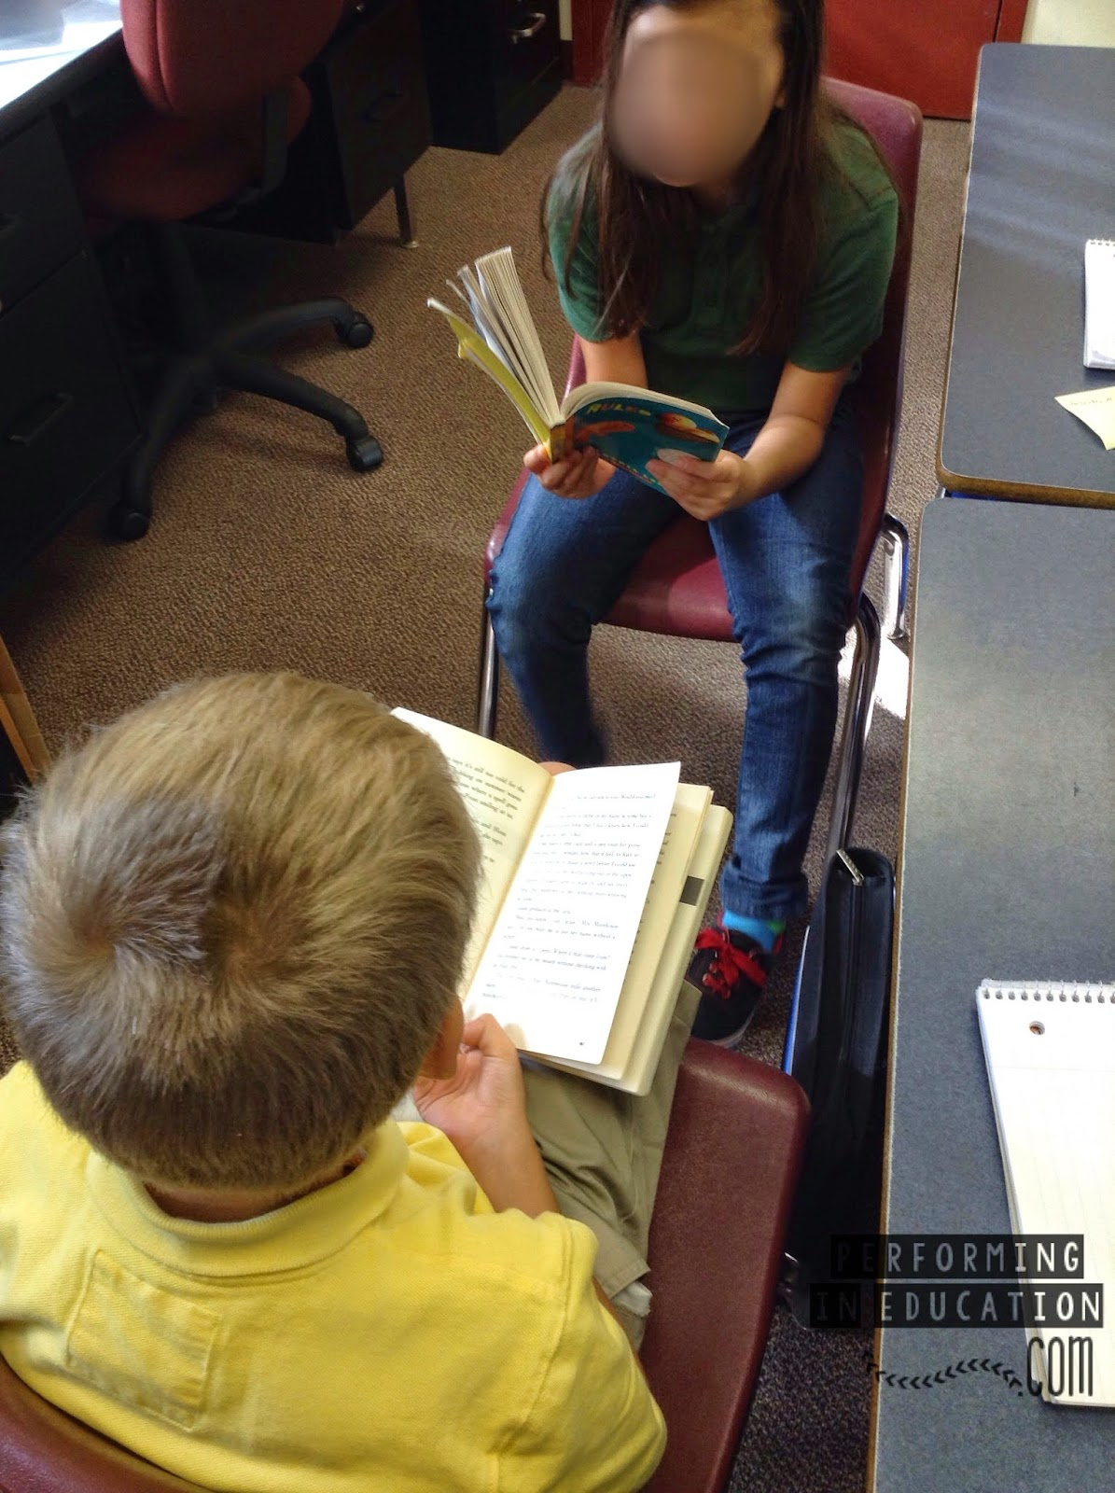
Whole Brain Learning
“Class” – “Yes”
Hands & Eyes
“Before you share” – “Put ‘em in the air”
Mirror
Scoreboard
“Teach” – “Okay”

