Slide 1
Gender Studies ID-4 Ms. Lindsay
Aim: What “invisible” privileges do we have?
Do Now: Look at the maps in your groups, then answer these questions: What are the differences between these 2 maps? Which is the real map?
HW Due Today: List of 3 biases.

Slide 2
Mercator map Gall-Peters map

Slide 3
What it looks like…
Alaska = continental US
Greenland = Africa
Europe almost same as South America.
Antarctica = biggest continent
In reality…
Alaska = 1/3 of the continental US
Greenland = 1/14 of Africa
South America = 2x Europe
Antarctica = second-smallest continent.

Slide 4
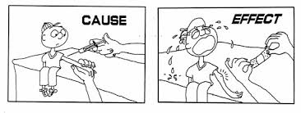
Why do we use the Mercator map? What effects might this have on the way people think of the world?

Slide 5
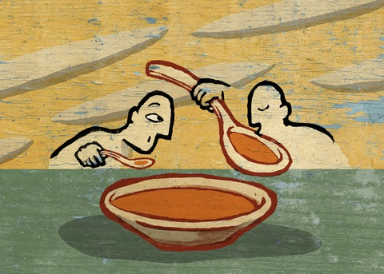
VOCABULARY
Privilege –
Dominant –
Subordinate –
Notes:
unearned (lucky) ability to do something / having an advantage, being able to do something other people cannot do
*Exs: phone, education, 2 working legs, rich
power/control over others / stronger, on top, more power, in control
under, being controlled / weak, being controlled, lower, less power, UNDER

Slide 6
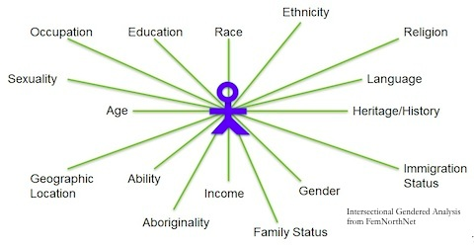
White Privilege: Unpacking the Invisible Knapsack by Peggy McIntosh
Notes:
Why does McIntosh refer to privilege as an “invisible knapsack”?

Slide 7
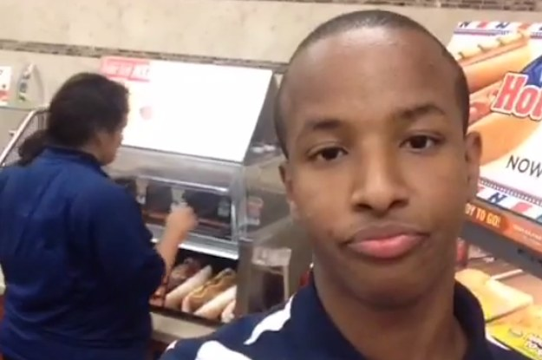
I can go shopping alone most of the time, pretty well assured that I will not be followed or harassed.

Slide 8
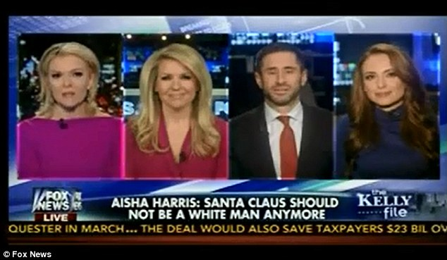
I can turn on the television or open to the front page of the paper and see people of my race widely represented.

Slide 9
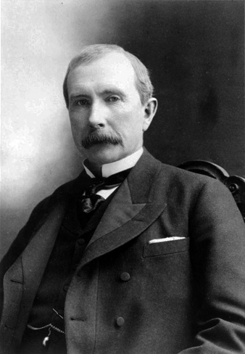
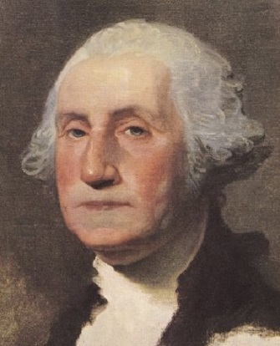
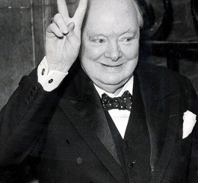
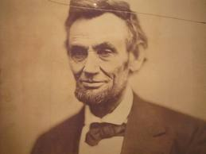
When I am told about our national heritage or about “civilization,” I am shown that people of my color made it what it is.
Notes:
Skip?

Slide 10
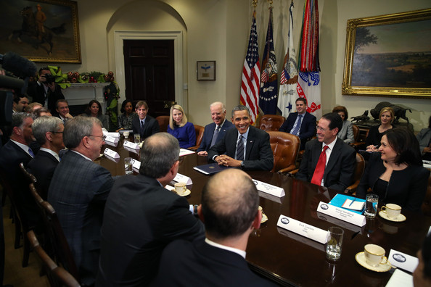
I can be pretty sure that if I ask to talk to the “person in charge”, I will be facing a person of my race.

Slide 11
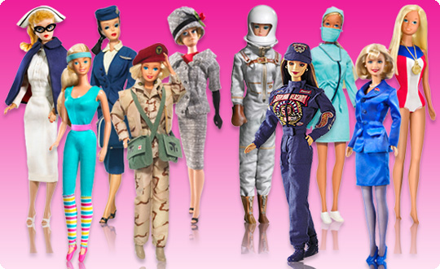
I can easily buy posters, post-cards, picture books, greeting cards, dolls, toys and children’s magazines featuring people of my race.

Slide 12
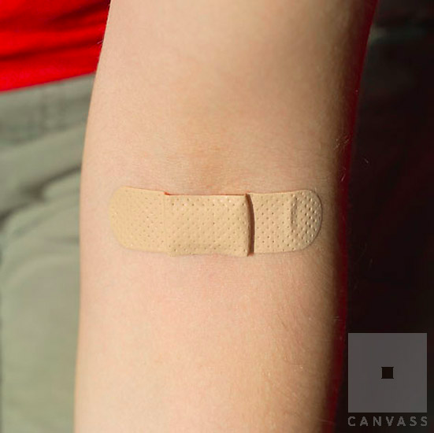
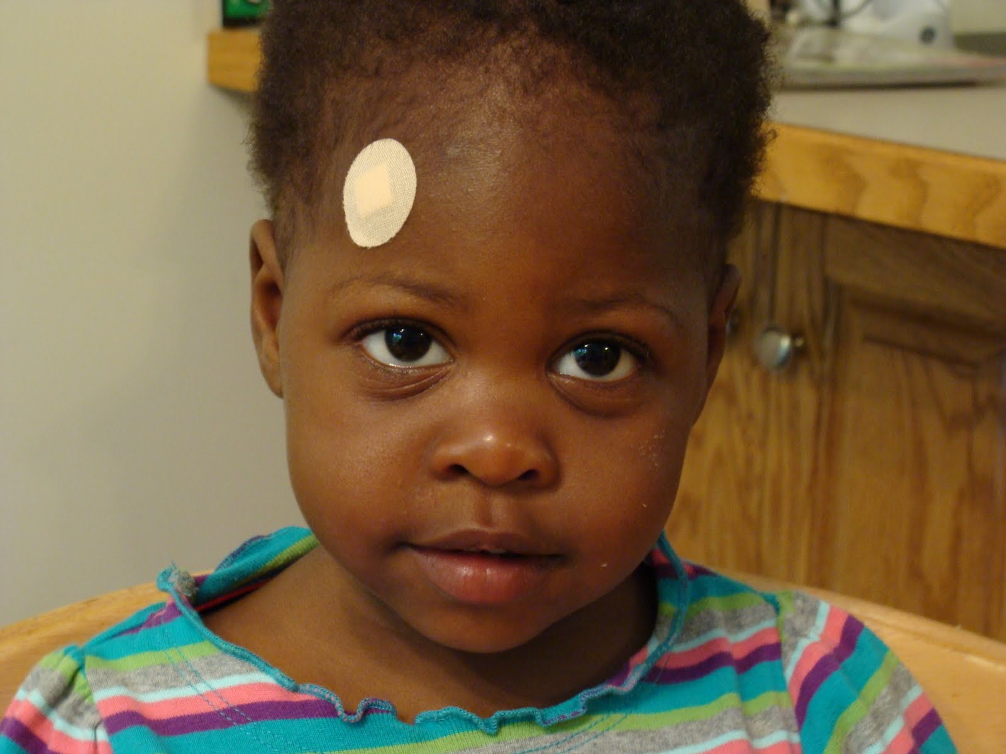
I can chose blemish cover or bandages in “flesh” color and have them more or less match my skin.

Slide 13
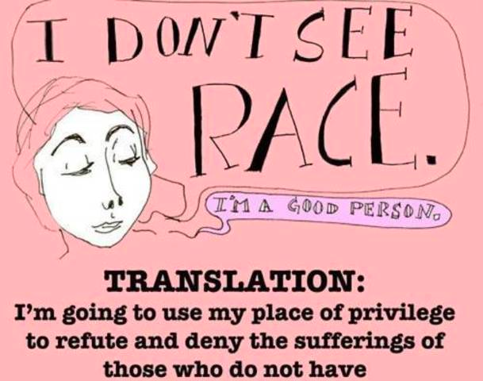
Why is it important to make it visible to yourself?
Notes:
Does white privilege differ by country?

Slide 14
What other parts of a person’s identity are privileged? Language religion nationality ethnicity gender class sexuality

Slide 15
In your groups…
Choose another axis (part) of a person’s identity & make a list of privileges for that axis.

Slide 16
HOMEWORK

