Slide 1
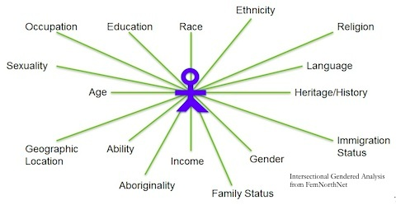
Gender Studies ID-5 Ms. Lindsay
Aim: What is intersectionality?
Do Now: Finish your list of privileges from last class (based on one axis of identity). Be ready to share with the class!
HW Due Today: identity matrix worksheet

Slide 2
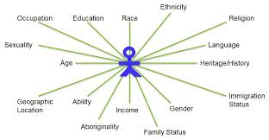
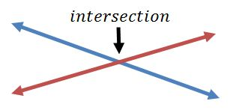
VOCABULARY
intersectionality –
Notes:
all parts of our identity works together/meets to make us who we are & our experiences
when all parts of our identity come together (the mix shapes who we are & our life experiences
all parts of our identity meet together to shape who we are & our experience

Slide 3
IDENTITY UNIT OUTCOMES Gender Studies
CONTEXT – ask & answer “Why?” questions
VOICE – word choice, rhythm, sentence variety
CONVENTIONS – spelling, punctuation, grammar, & citations
DISCUSSION – convincing oral arguments
CONNECTIONS – to text, social issues, & identity

Slide 4
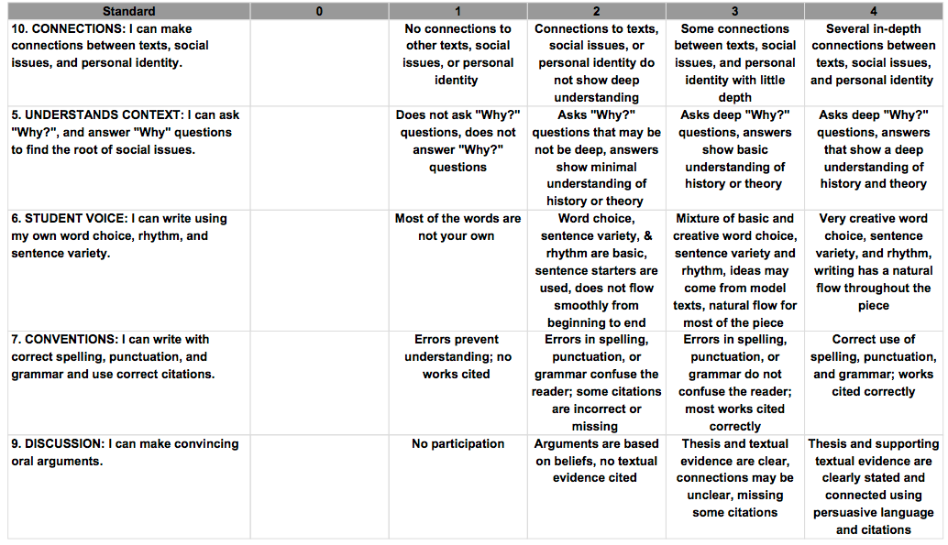

Slide 5
World as 100 People Homework
Notes:
Not really 100 people, but it’s a % (100%) and each person represented is a percentage of the 100

Slide 6
Jigsaw
Read text (one person can read aloud). 5 mins
Write a comment or question on your paper. 5 mins
IN GROUPS: Discuss your comments and questions. Determine the MAIN IDEA. 5 mins

Slide 7
MODEL
“…[the black woman] remains single more often, bears more children, is in the labor market longer…has less education, earns less, is widowed earlier, and carries a…heavier economic responsibility as family head than [a white woman].”
- from The Liberation of Black Women (1970)

Slide 8
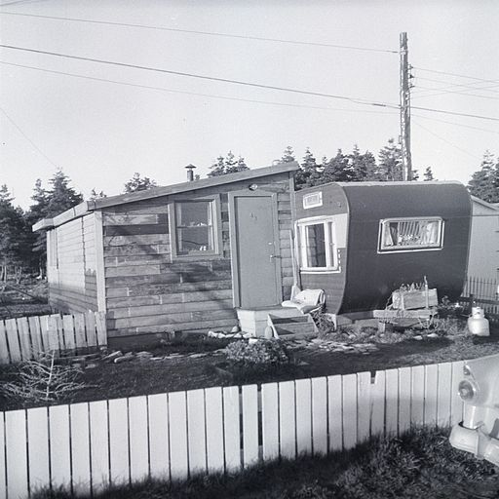
Explaining White Privilege to a Broke White Person By Gina Crosley-Corcoran
This is actually a much nicer trailer setup than the one I grew up in.

Slide 9
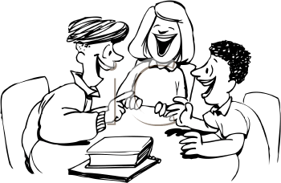
Collaborative Annotating
Read. 5 mins
Write on your paper. 5 mins
IN GROUPS: Discuss.
Determine main idea. 5 mins

Slide 10
Share out
Group 1
Group 2
Group 3
Group 4
Notes:
Discussion Questions – what’s the main idea of the whole piece?

Slide 11
HOMEWORK: Bias (Part 2)

