Slide 1
Gender Studies ID-6 Ms. Lindsay
Aim: What is gender and how can it be privileged?
Do Now: How are females treated differently than males in our society?
HW Due Today: Understanding Bias (Obama)
Notes:
Girls, do you like being girls? Boys, do you think life would be easier as a girl?

Slide 2
What Don’t You Like About Being A Girl? By Eve Ensler
Girls can’t control anything
Boys can do whatever they want
My brother is adored.
I am ignored
My boobs, people talking
about my boobs
People assuming you can’t do something
My boobs, it all changed with my boobs
Blood, cramps, seven days
People thinking you are weak
A girl can get pregnant
You have to do your hair
You have to remove your hair
Wash and iron clothes
More chances of being raped
Have to take care of husbands and kids
Girls can’t work even though
they are educated.
Notes:
OR “Being Woman” by Kim Dominguez (from Revolutionizing Education)
I
Was created in the act of oppressing women…
A man with a girl only 15
Mothers let your daughters become mothers way too soon
Young housewives…so tired of cleaning
Grandfathers make granddaughters give them a massage
Mija’ take my shows off, rub my feet
TRAIN THEM EARLY
KEEP TRADITIONS GOING
Abuse so tired of abuse
Looking at holes in the wall punched by angry men covered with pictures of fake smiles…
Women seeking happiness as all the rest in this place
I’M NOT your mother
I’m not my mother
So what if I don’t feel like cleaning
Washing dishes
Or peeling potatoes?
And if that means I won’t be a good mom then I’ll do the unthinkable and not have kids
I hear people judging me
Do they think they’re jesus?
I am rude
I should wear makeup
I should lose weight
Maybe I oppress food consuming it violently, the only thing that doesn’t swing
I can be in control, no talking, no sex, no apologies
When I want what I want all I need just like this world is money$$$
I HATE when people only have time for a two minute conversation and ask how you are doing…fine, nothing… thinking to myself
Do they really want to know?
I don’t care I blurt out
Eviction, corruption, and mutilation of my body, house, neighborhood, relationships…
Life all this stress, oppress, and chores cause I’m not a man
Well good luck with that as he turns around and starts to walk away
I think walk away…turn away…run away…
As all men do
Men are clams
Women are crowbars
A quote by a god fearing Christian man
Am I a crowbar? Do I pry? Do I go too far? Should I wear makeup?
In the bathroom reading my seventeen, my, teenbeat, cosmo, feeling schizophrenic
I think to myself thank god for dishwashers, I’ll get up and load the dishes, or throw away my magazines
A proud “feminist” who still feels fat, ugly and scared of men at the end of the day
And dreams of romance while she’s sleeping

Slide 3
Why do we see girls as less than boys?
Notes:
Show Like a Girl video

Slide 4
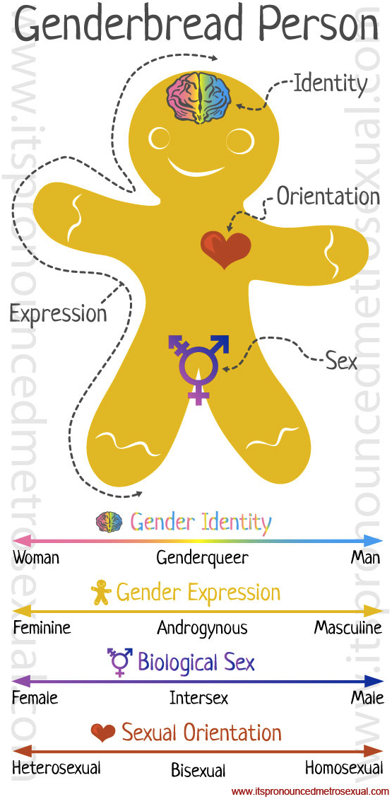
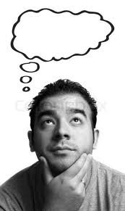
VOCABULARY
Gender –
Sex –
Sexism –
Notes:
identity (what you think you are)
biological, genitals, physical
ideas that treat people badly because of their sex / putting people down because of their sex

Slide 5
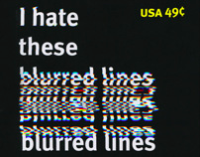
Do you know Robin Thicke’s song “Blurred Lines?” What is it about?
Notes:
Show video with lyrics

Slide 6
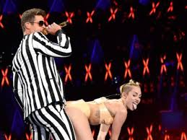
What do we think about him for writing this song? At the 2013 VMAs, Miley Cyrus twerked to this song. What do we think of her for doing that?
Notes:
*“we” could mean society and/or the class
Show MSNBC’s response video to Miley Cyrus

Slide 7
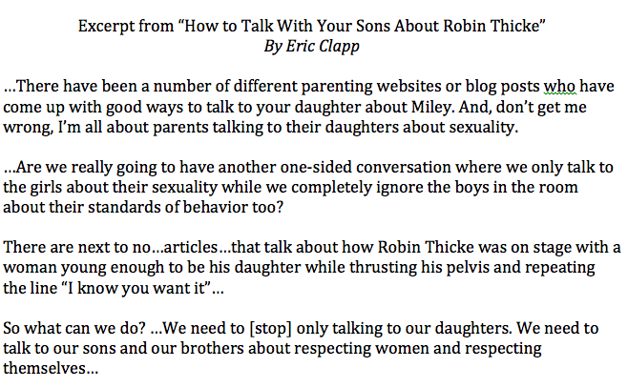
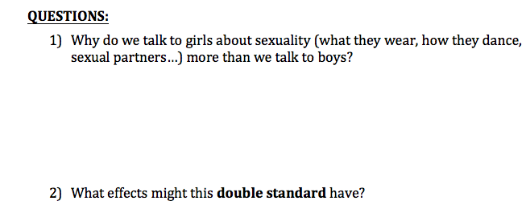
HOMEWORK
*double standard
Notes:
Define the word double standard

