Slide 1
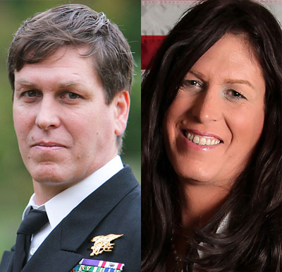
Gender Studies ID-7 Ms. Lindsay
Aim: What is gender and how can it be privileged?
Do Now: Where should
transgendered people
go to the bathroom?
HW Due Today: “How to Talk to
Your Sons About Robin Thicke” questions

Slide 2
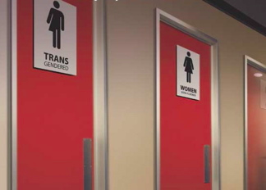
Why do we have separate bathrooms? What is the best way transgendered people can feel comfortable using the bathroom?

Slide 3
Legally…
Businesses in NYC that do not allow transgendered people to use gender-identity appropriate restrooms may be violating the city’s nondiscrimination law.
In a non-workplace, it is not against the law to prevent transgendered people from using an identity-appropriate restroom.

Slide 4
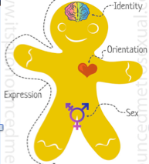
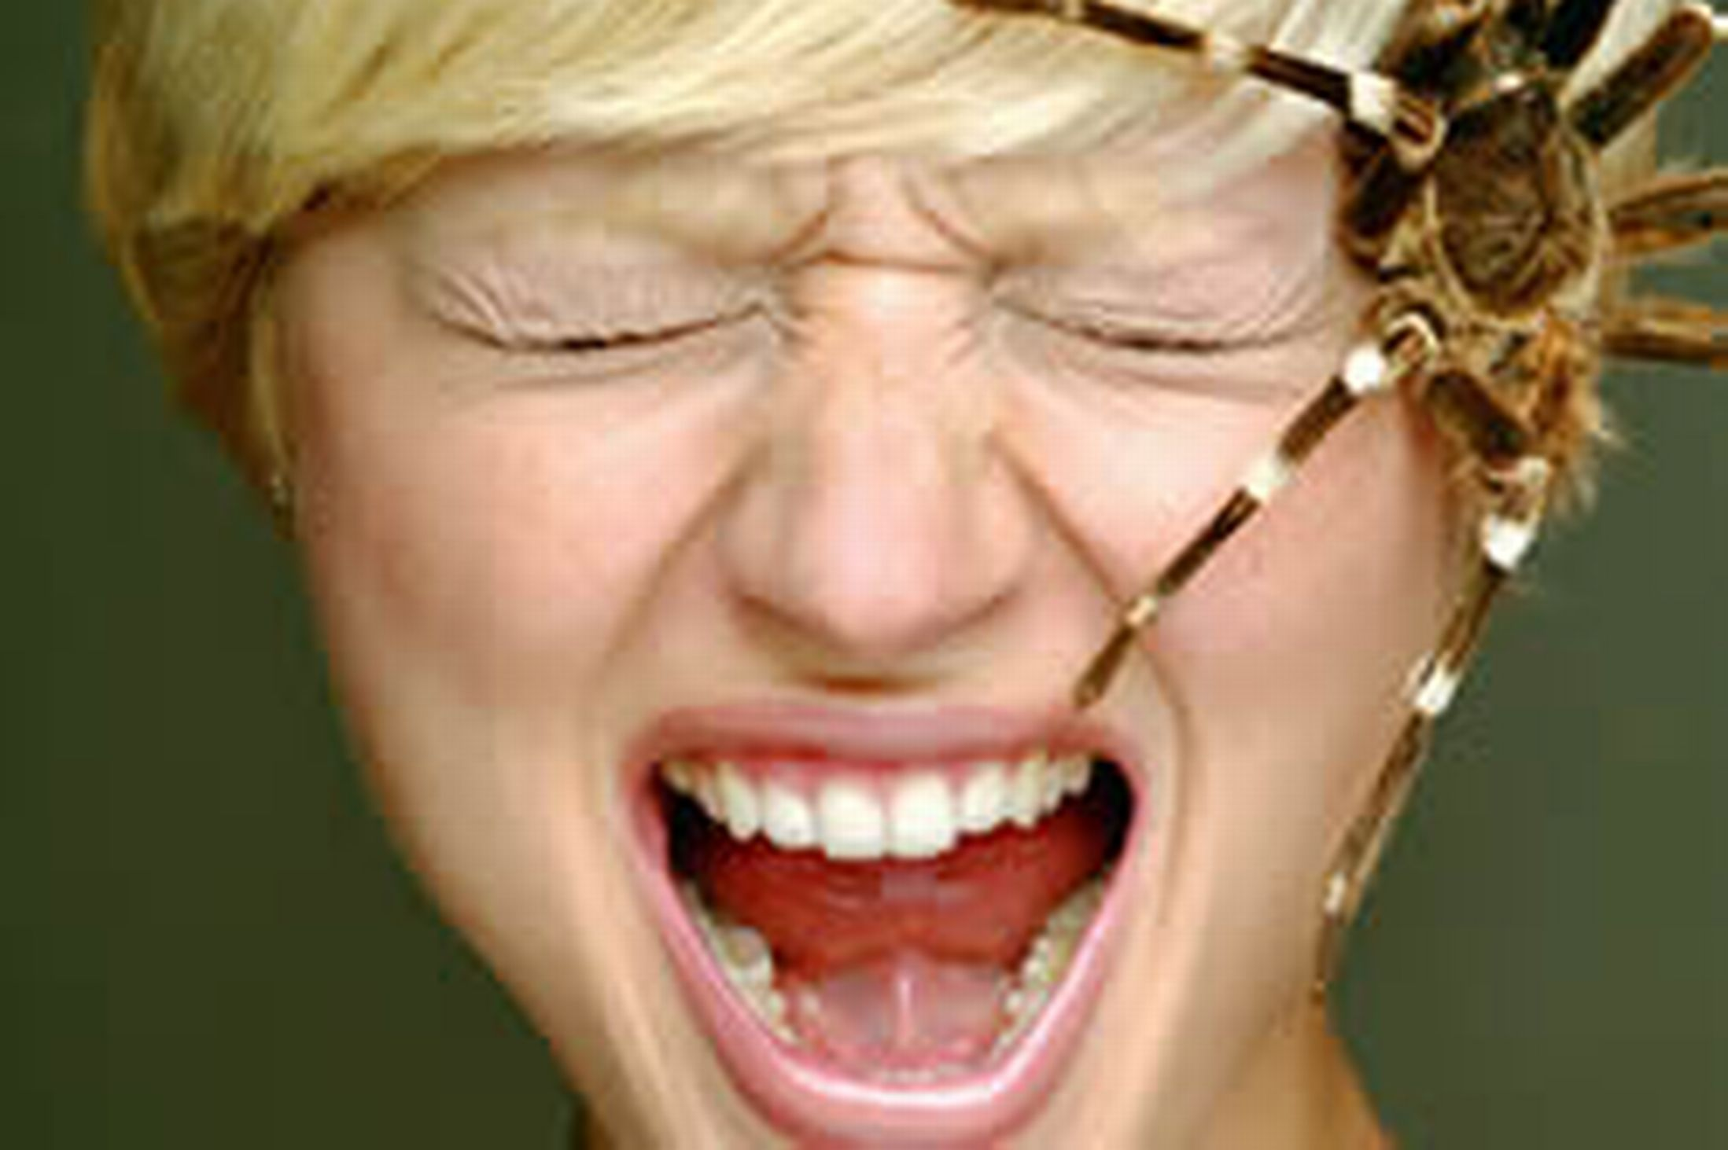
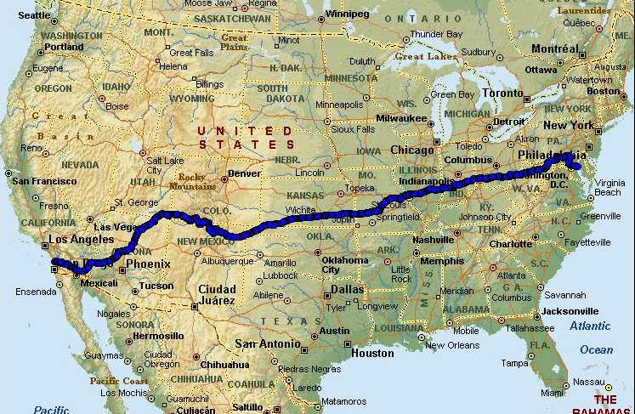
VOCABULARY
Transgender –
Transphobia –
Gender binary –
Notes:
“misia” – hatred
gender does not match sex
Fear of transgendered people (hatred)
idea that there are only 2 genders (problem)

Slide 5
Interview
Cisgender: your gender identity
matches your biological sex
What were some of the questions asked?
Why are questions about your body inappropriate during an interview about your work?
How does watching this video help us?

Slide 6
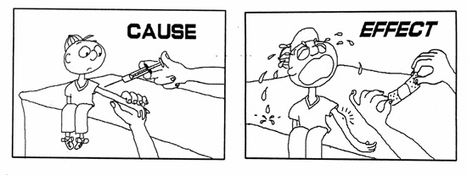
Mom’s Speech
Why would parents try to stop a transgendered child from being herself?
What effects could this have?
What is the root cause of trans-hatred?
How does religion play a part in
trans-hatred?

Slide 7
3 Markers
Insistent (firm)
Consistent (no change)
Persistent (over long period of time)
*They say who they are NOT

Slide 8
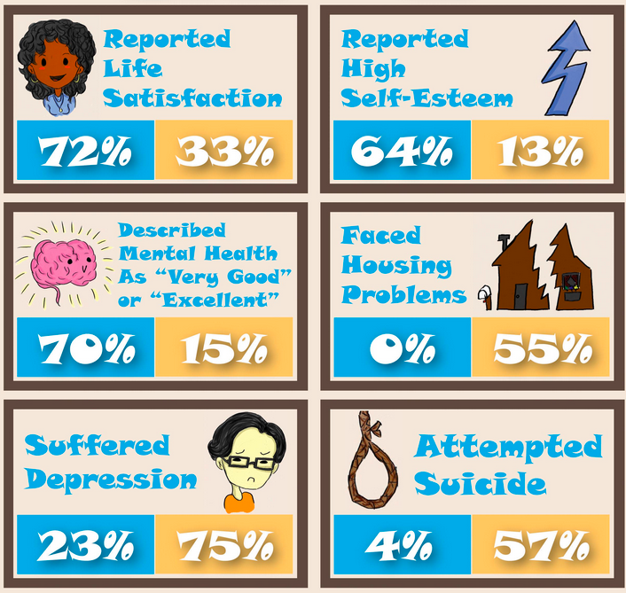
HOMEWORK

