Slide 1
Gender Studies ID-8 Ms. Lindsay
Aim: How do different races experience our society?
Do Now: Read the article at your table.
Each person will write 1 comment or question. Discuss as a group & determine the main idea.
HW Due Today: Transgender Statistics & article

Slide 2
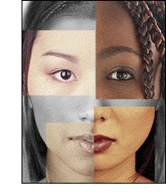
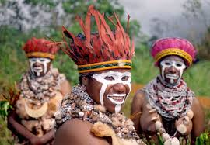
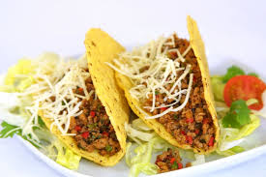
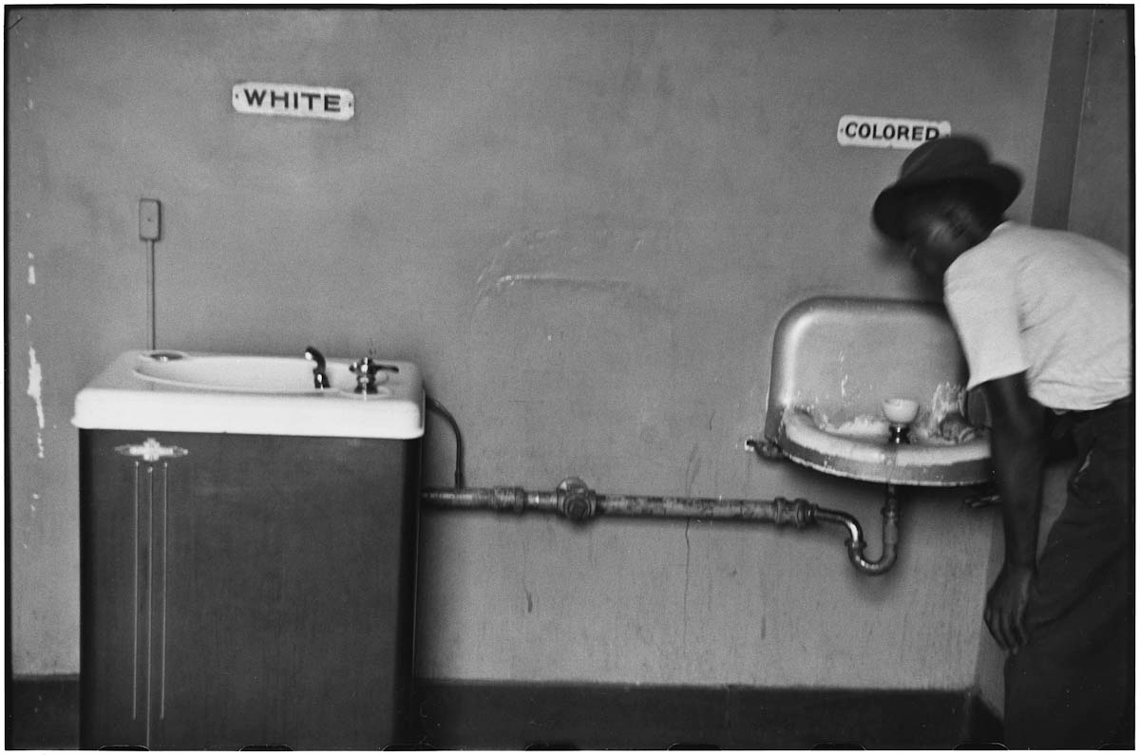
VOCABULARY
Race –
Ethnicity –
Racism–
Notes:
Physical/cultural
Institutionalized discrimination/not as much

Slide 3
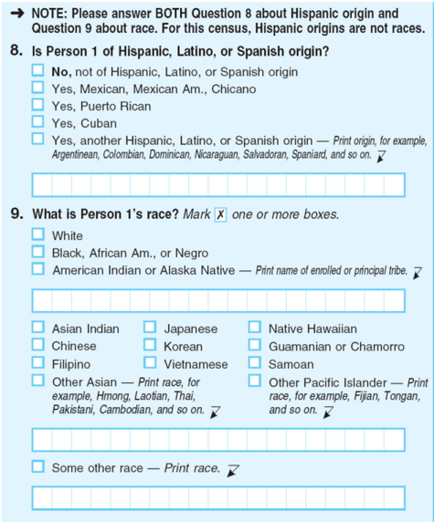
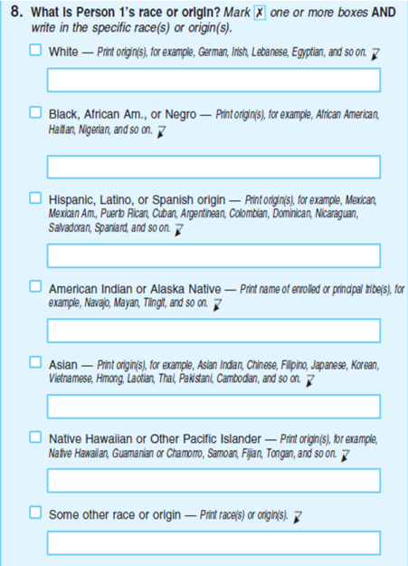
How should we use “race” & “ethnicity”?
Notes:
Left = current census form, Right = experimental (many Latino/as check “other race” & write in Latino/similar term)
http://www.pewresearch.org/fact-tank/2014/03/14/u-s-census-looking-at-big-changes-in-how-it-asks-about-race-and-ethnicity/

Slide 4
Is racism always obvious?

Slide 5
How else do people experience “subtle” racism?

Slide 6
Discussion
What other race/ethnic group should have a video? What would the actors say?
Why does “subtle” racism exist?
What are the effects of this type of racism?
How can we stop this type of racism?
Notes:
Take 10 mins in groups, then share out

Slide 7
HOMEWORK: Bring headphones tomorrow!!!
Notes:
Just watch it – no written assignment tonight

