Slide 1
Gender Studies ID-9 Ms. Lindsay
Aim: How do different races experience our society?
Do Now: Read the infographic at your table.
Each person will write 1 comment or question. Discuss as a group & determine the main idea.
HW Due Today: None

Slide 2
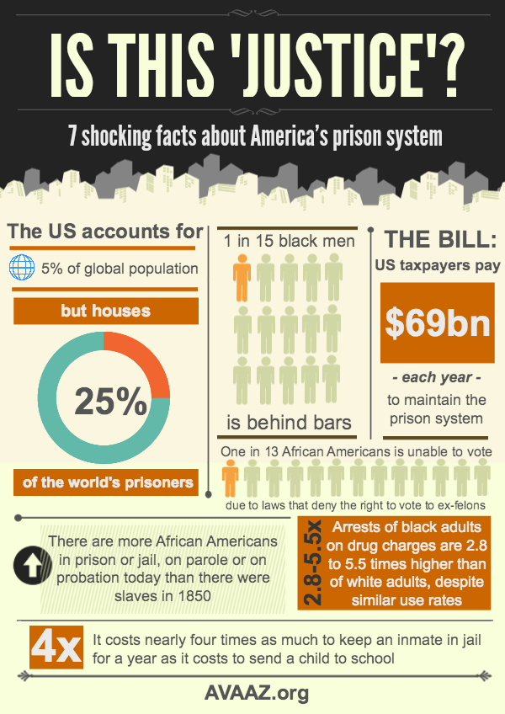

Slide 3
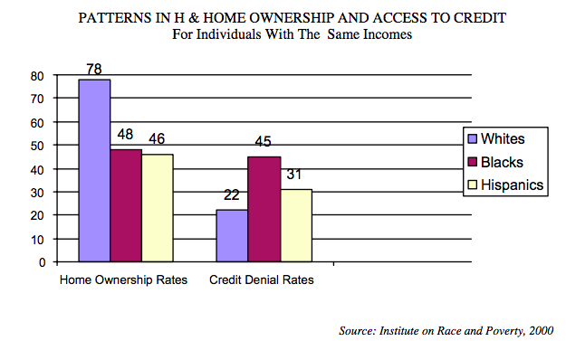
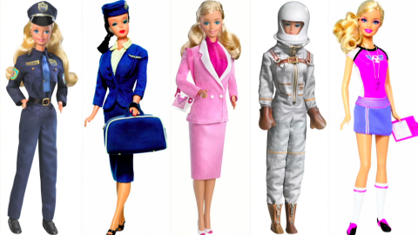
VOCABULARY
systemic racism-
Notes:
system-wide (schools, companies, laws) form of racism
-ic suffix = “relating to”
Within systemic racism: institutional racism & structural racism
Involves: HISTORY, CULTURE, INSTITUTIONS & POLICIES
Examples include racist history, dominant cultural representations, popular myths, and compounded and chronic inequities, etc.
(from http://www.intergroupresources.com/rc/Definitions%20of%20Racism.pdf)

Slide 4
Is this individual racism or systemic racism? Why?
What effects could this type of racism have?
Does this connect to anything else we’ve studied?
Notes:
Answer questions for each video

Slide 6
For the Muslims Post-9/11 Video… You only have to watch 1:40-6:03

