Slide 1
CHOOSE ONE QUOTE & RESPOND
“If we don’t learn from the past we’re bound to repeat it.”
Unknown
“All our ancient history…is no more than accepted fiction.”
Voltaire
“History is written by the winners.”
Alex Haley

Slide 2
Rules for Discussion
See poster.

Slide 3
http://www.tolerance.org/sites/default/files/general/tt_santa_turban_activity_2010.pdf

Slide 4
Answer about your picture:
1) What kind of emotions instantly come to you when you see this picture? 2) Where do you think you learned about this individual? 3) Who taught you about this individual? What did they teach you? 4) How has the media (TV, movies, books, stories) shaped your image of this individual? 5) How long have you known about this individual? 6) Have you ever personally seen this individual? 7) Have you ever seen someone dressed like this individual? 8) Have you ever personally known someone who looks like this individual?

Slide 5
Discussion Questions
What is different in the two images?
Looking at our responses we've recorded on the board, what is similar or different about them? Why?
Does it matter that most of you have had some experience with Santa during your lifetime? Why or why not?
Would your responses to the image of the turban change if you knew someone personally for many years that wore one?
What do you think we can learn from what we've done here?

Slide 6
How do we see things? Does that make it true?

Slide 7
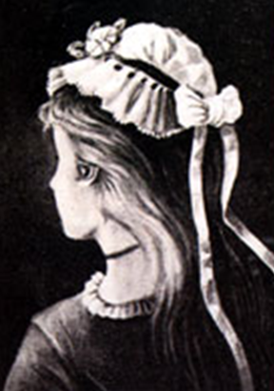

Slide 8
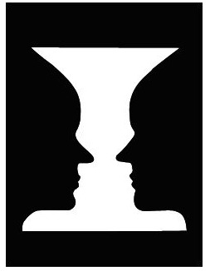

Slide 9
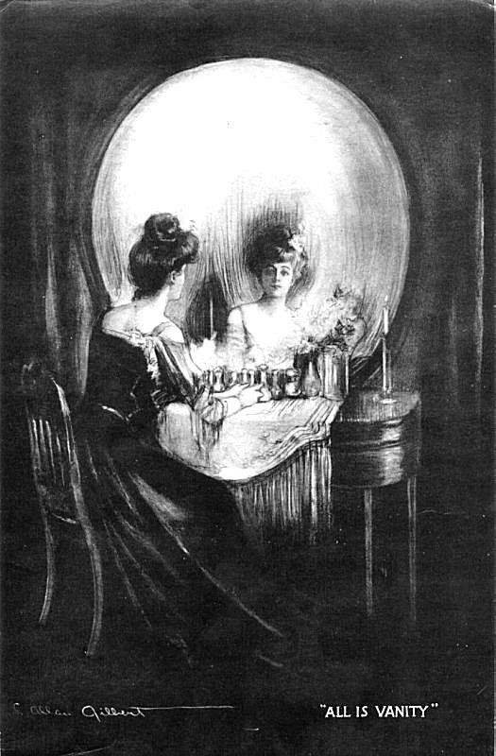

Slide 10
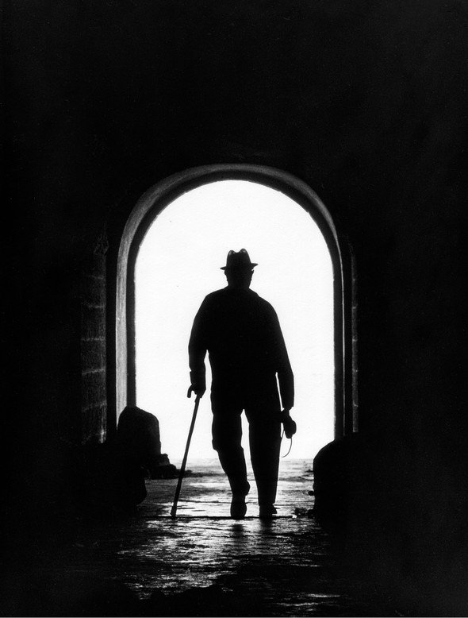

Slide 11
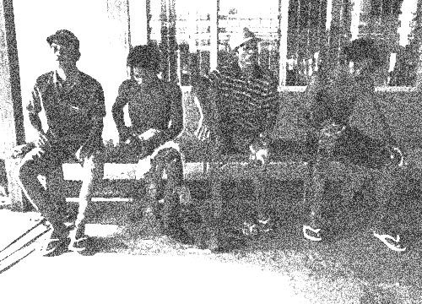

Slide 12
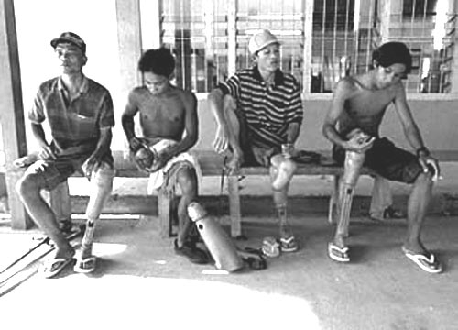

Slide 13
What is bias?
Definition

Slide 14
http://www.youtube.com/watch?v=iYhCn0jf46U

Slide 15
What’s the Point?
QUESTION EVERYTHING.
Brilliant thoughts & questions
will go on the wall!

