Slide 1
Gender Studies MED-11 Ms. Lindsay
Aim: How has the media played a role in cases of police brutality against young men of color?
Do Now (IN YOUR GROUP): Read the article and look at the pictures on the back. Answer the question: What is going on in Ferguson?
HW Due Today: Seminar Reflection
Notes:
How did the media cover Ferguson? What examples of good reporting can you find? What examples of coverage you consider problematic did you see?
What bias or stereotyping did you witness in media coverage, whether in choices of words, images, headlines, interviews or anything else? How do you think that may have affected perception of the events and their meaning?
Do you think the Times’s profile of Michael Brown was biased or unfair? How would you respond to the public editor’s column about it?
What role did social media play in this story?
How is social media affecting how news breaks, is reported and is responded to in general? What examples can you give beyond Ferguson?

Slide 2
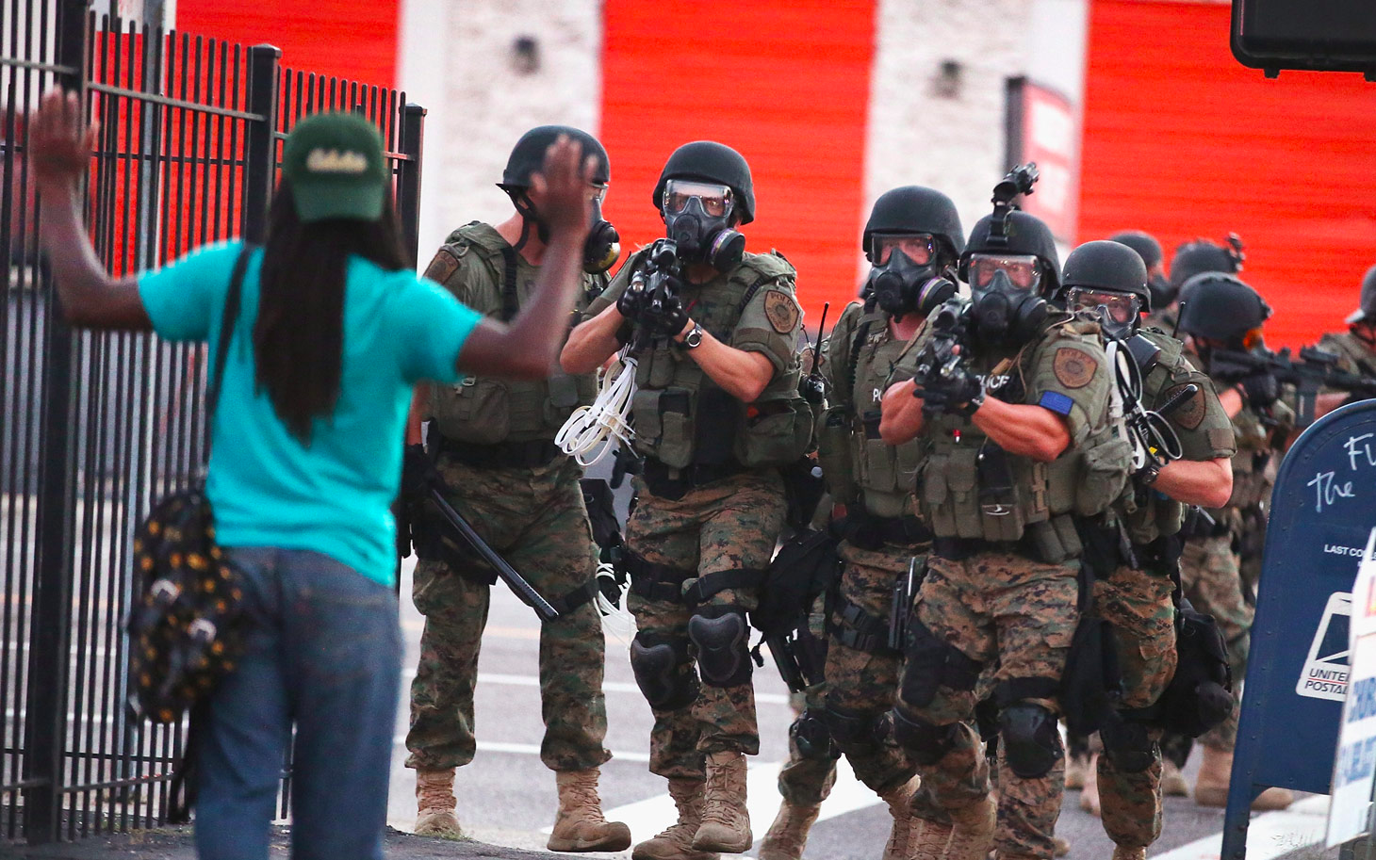
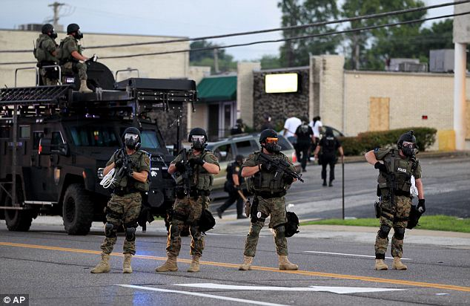
Response to Protests in Ferguson

Slide 3
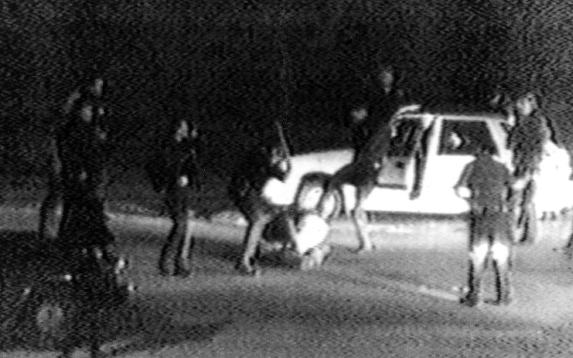
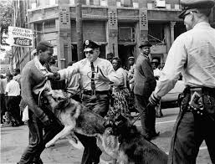
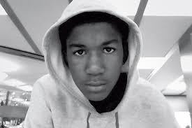
This is not the first time…

Slide 4
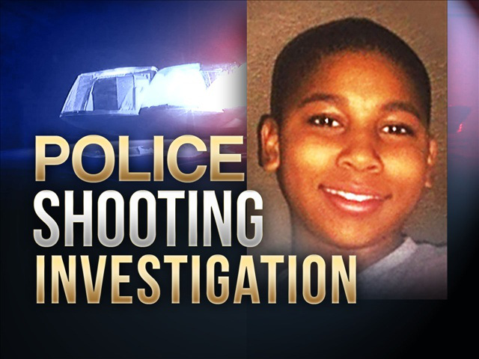
Nov. 22, 2014: Police shot 12-year old boy with fake gun
Notes:
http://www.cleveland.com/metro/index.ssf/2014/11/cleveland_police_officer_shot_1.html

Slide 5
Among young men, blacks are 21 times more likely to die at the hands of police than their white counterparts.
Notes:
http://thesocietypages.org/socimages/2014/11/28/chart-of-the-week-63-of-white-people-are-wrong-about-ferguson/

Slide 6
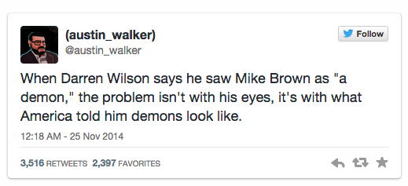
Why is this happening?

Slide 7
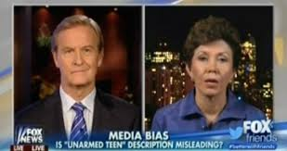
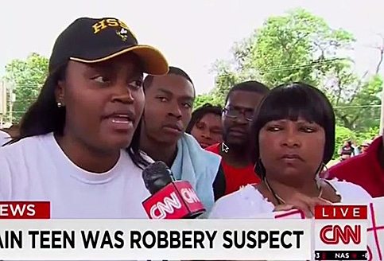
Media Coverage
Michael Brown, 18, due to be buried on Monday, was no angel… - New York Times
Notes:
SHOW JOHN STUART CLIP

Slide 8
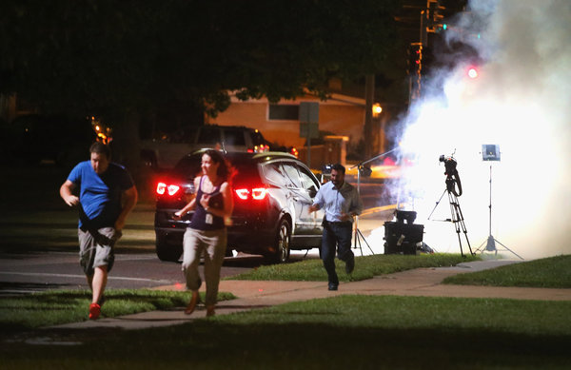
Media – not allowed
Officers…tear-gassed a [news] crew from Al Jazeera.
Two reporters [of[The Washington [and] The Huffington Post, were arrested at a McDonald’s.
[A man] documenting the protests and the [response] on Twitter, was arrested as well.
Notes:
http://www.nytimes.com/2014/08/18/business/media/view-of-ferguson-thrust-michael-brown-shooting-to-national-attention.html

Slide 9
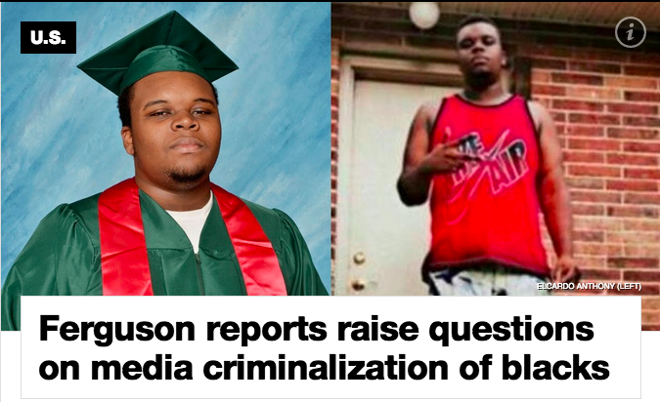
Read this article & fill in the row on your organizer.
Notes:
Read article
CRIMINALIZATION

Slide 10
“Ferguson reports raise questions on media criminalization of blacks” article
Main Idea | Help/Hurt | Evidence | Analysis
Notes:
MI: Media shows black teens as bad
H/H: Hurt
Evi: White men with guns – nothing happens, black men get shot (Trayvon Martin, Renisha McBride, Amadou Diallo)
Ana: Media blames blacks for being shot (racism) – choice of pictures

Slide 11
Social Media
…Mainstream media leaves communities of color unmoved — [they] are…underrepresented in terms of [cable] access as well — Twitter is a place many black users rely on for information
Notes:
http://www.nytimes.com/2014/08/18/business/media/view-of-ferguson-thrust-michael-brown-shooting-to-national-attention.html

Slide 12
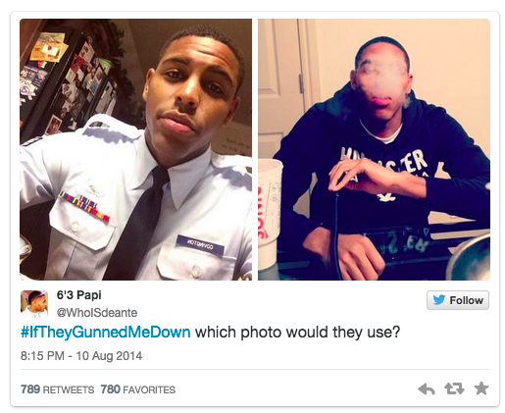

Slide 13
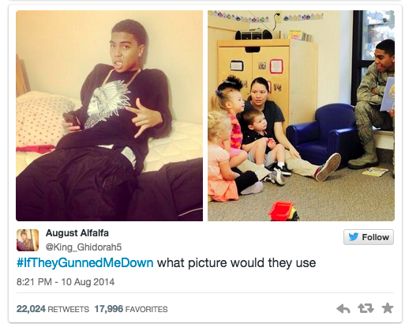

Slide 14
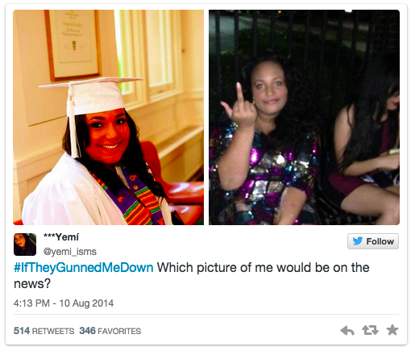

Slide 15
Summarizing Questions
How does the media represent young men of color?
What can we do about it?

Slide 16
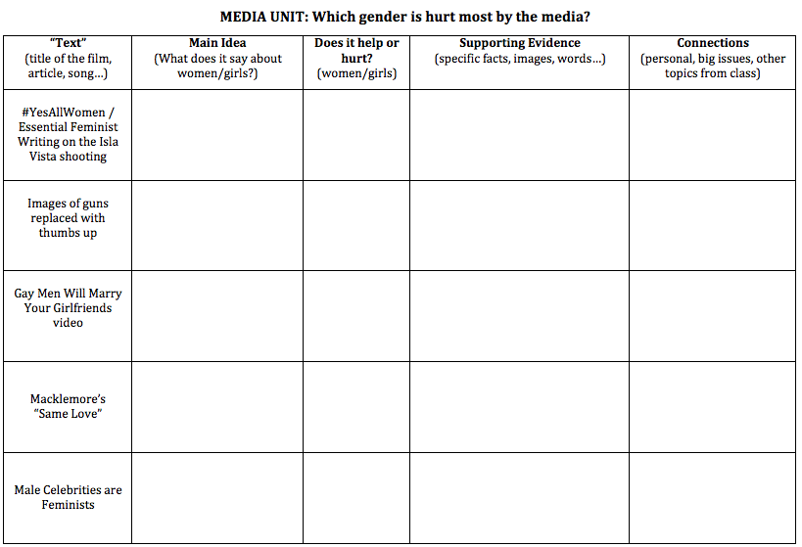
HOMEWORK
Choose 3 of the 5 texts to summarize in your organizer
Due MED-17: Wednesday, December 10th

Slide 17
Extra…

Slide 18
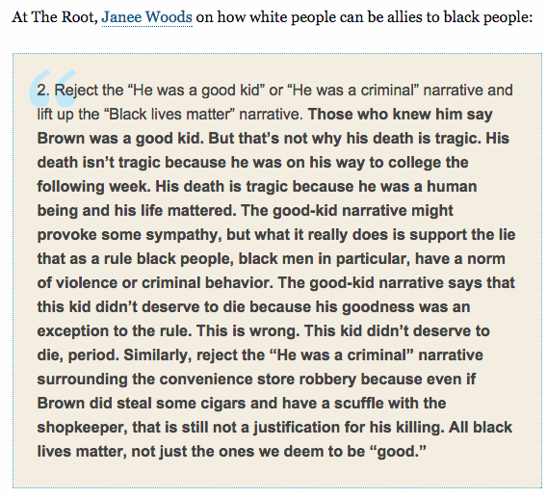

Slide 19
1999: Amadou Diallo
We proceeded on a country road
His mother’s eyes red and swole
Her child was never comin’ home
Said a prayer for his soul
As the coffin had closed, committed to the earth below
First seed she had sown, would be a tree never grown
Shade that was never known
Who controls the Terrordome, the men with hearts made of stone
Who love only what they own
—Mos Def, “Tree Never Grown,” Hip Hop for Respect (2000), in response to the killing of Amadou Diallo

Slide 20
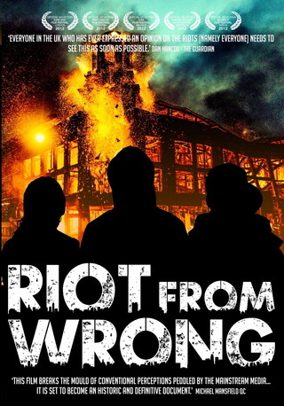
Here’s what happened in London in 2011…

