Slide 1
Gender Studies MED-12 Ms. Lindsay
Aim: How are the media’s messages affecting men?
Do Now (IN YOUR GROUP): How do you think men are affected by the media? (What messages do they receive? How do they feel about themselves? How do they act?)
HW Due Today: Work on the packet – finish 3 of the 5 texts by Wednesday, Dec. 11th.

Slide 2
According to the trailer for Tough Guise 2, how does the media affect men?

Slide 3
Tough Guise 2 trailer
Main Idea | Help/Hurt | Evidence | Analysis
Notes:
MI: Media shows men as violent, which leads to men being violent in real life.
H/H: Hurt / Helps (video points this out)
E: Movies show men with guns, school shooting, Batman movie shooting
Ana: The race of the shooters was white. 1 got mental help instead of prison.

Slide 4
As we watch the Law and Order: SVU episode called “Holden’s Manifesto,” please look for evidence to write in your organizer.

Slide 5
SVU episode “Holden’s Manifesto”
Main Idea | Help/Hurt | Evidence | Analysis
Notes:
MI: The guy wants to hurt the girls who don’t have sex with him.
H/H: Hurt
E: Makes a video & manifesto about punishing girls who say no to him
A: Boys should express their feelings in a non-violent way

Slide 6
Based on a true story

Slide 7
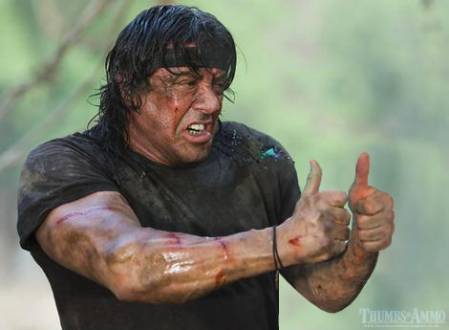
Related “Texts” (Choices for homework)
Isla Vista feminist response (#YesAllWomen)
Images of guns replaces with thumbs up

