Slide 1
Gender Studies MED-13 Ms. Lindsay
Aim: What is hegemonic masculinity?
Do Now (IN YOUR GROUP): Look at the article at your table. Fill in the row, “Be a man: Macho advertising…” article.
HW Due Today: **#YesAllWomen Packet from yesterday.
Keep working on texts packet. 3 due by next Wednesday (December 10th.)

Slide 2
Be a Man… article
Main Idea | Help/Hurt | Evidence | Analysis
Notes:
MI: Men are also affected by the media, Ads show hyper-masculinity which hurts men.; Media tells men to be violent., Media makes men unhappy with their bodies.
H/H: Hurt (men), Help (women don’t feel alone); Hurt
E: “Men are increasingly affected by media…about body image.”, 56% of ads showed hyper-masculinity; Men are unromantic; A 2008 study, Tough = control emotions, Violence = manly, 56% of ads shows hyper-masculinity
A: Women are not alone in being hurt by the media, Media causes men to use violence when sad/mad.; It’s not just women that are affected by the media.

Slide 3
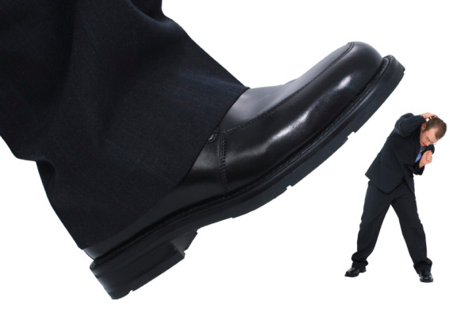
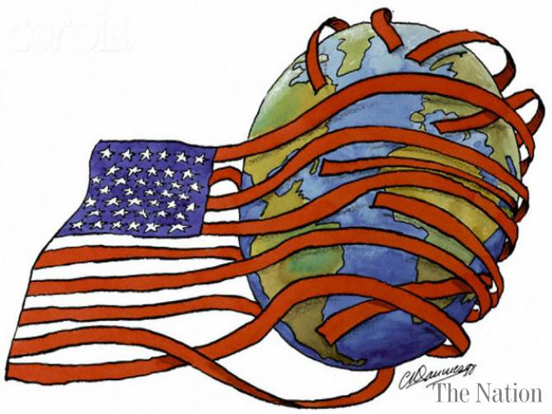
VOCABULARY
Hegemony –
Notes:
Segement into syllables…dominance or power over others

Slide 4
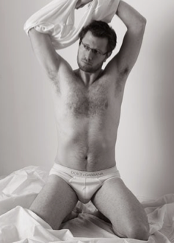
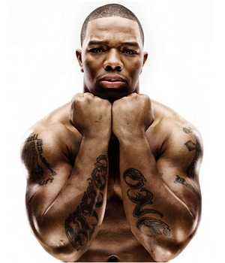
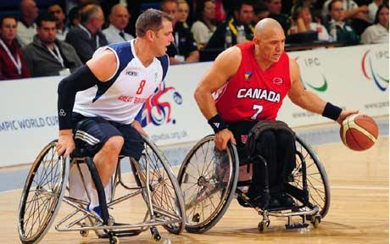
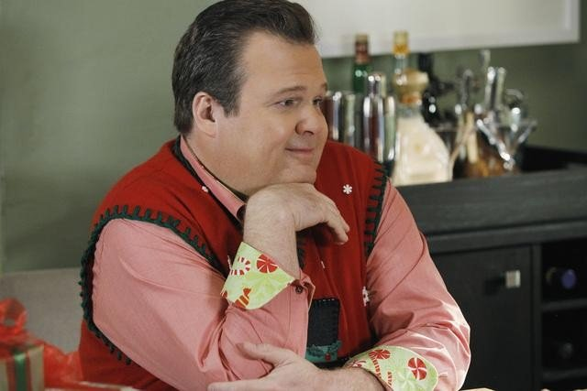
COMPLICIT
MARGINIALIZED
HEGEMONIC
MARGINIALIZED
SUBORDINATE

Slide 5
Connell’s “Hierarchy of Masculinities” theory
Main Idea | Help/Hurt | Evidence | Analysis
Notes:
MI: There are different classes of men; Society chooses only white, strong men to be in the media.
H/H: Hurt, Help (hegemony); Hurt, Helps (white men)
E: Hegemony (underwear ad), Complicit (trying to be a model), Marginalized (black, wheelchair), Subordinate (gay man); Hegemonic – white model, Complicit - white guy trying to be a model, Marginalized – black, dis/ability, Subordinate – gay men
A: It’s important to raise awareness of this discrimination & defend ourselves,; Media creates biases and stereotypes., All men are not treated equal. Women and men have low self-esteem because of the media.

Slide 6
As you watch both clips of Tough Guise, please look for evidence to write in your organizer.

Slide 7
Tough Guise (intro stats)
Main Idea | Help/Hurt | Evidence | Analysis
Notes:
MI: Real men should not be “tough” but emotionally healthy.; Men need to be tough & be independent (and the “toughness” expectation is growing.)
H/H: Hurt (media), Help (this movie); Help (the video), Hurt
E: Women can help value “real” men, Movies show violence, 99.8% of rapists are men; Girls should value nice guys., Boys see they need to be violent (wrestling, guns). 76% of victims of homicide are men.
A:

Slide 8
Tough Guise (images of masculinity)
Main Idea | Help/Hurt | Evidence | Analysis

Slide 9
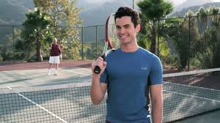
Related “Texts” (Choices for homework)
Gay Men Will Marry Your Girlfriends video

