Slide 1
Gender Studies MED-14 Ms. Lindsay
Aim: What messages does hip hop music send to men (and women)?
Do Now (IN YOUR GROUP): Read the article and try to fill in the row of your organizer called: Freestyle Rap Battle article.
HW Due: 3 of the 5 texts on the 3rd page of your yellow packet are due Wednesday, December 10th.

Slide 2
Freestyle Rap Battle article
Main Idea | Help/Hurt | Evidence | Analysis
Notes:
MI: Men are expected to win rap battles. Rap can lead to violence and hate.; Hip-hop has no place for women. Women who can rap are hurt.
H/H: Help – media didn’t cover it, Hurt – women & makes men bad; Hurt
E: Author is afraid to rap against men because they threaten to rape her, History of white men lynching black men; History – whites killed blacks in the South by lynching, 3 black men burned, shot, raped a woman
A: If men lose dominance, they may turn violent.; Hip-hop was created for black men to have a space to be powerful.

Slide 3
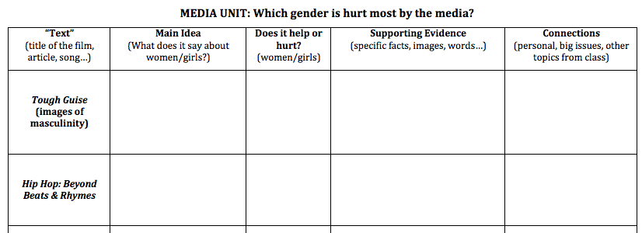
As we watch the Hip Hop: Beyond Beats & Rhymes, please look for evidence to write in your organizer.
Notes:
Is it an economic issue? (don’t have money, so exert power in other ways – physically, verbally?)
Why can’t we just smile at each other?
Can men cry? In front of their boys? In front of females?
Why does the culture of violence exist?
Where/when/how did it start?
Why does it still exist? (Are black men giving the white producers what they want, or is it genuine?)
How does hip-hop treat females?
How can we change all of this?
What may happen to us if we try to change things?

Slide 4
Hip Hop: Beyond Beats & Rhymes
Main Idea | Help/Hurt | Evidence | Analysis
Notes:
MI: Black men use rap as a way to show masculinity (they have been oppressed in history), but this leads to violence.; (Black) rappers will do anything (violence, misogyny, subordinate others) to get power. In history, white people have controlled them.
H/H: Hurt
E: Homicide victims are mostly black men, White men built a highway through the Bronx; White people get money easier, black men use violence (guns) & body size
Use of the n-word (reclaim)
A:

