Slide 1
Gender Studies MED-15 Ms. Lindsay
Aim: What do men who reject hegemonic masculinity look like?
Do Now (IN YOUR GROUP): Analyze the quote at your table. (What does it mean? How does it connect to class?)
HW Due: 3 of the 5 texts on the 3rd page of your yellow packet are due Wednesday, December 10th.

Slide 2
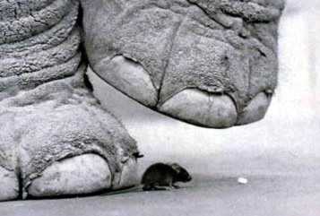
If you are neutral in situations of injustice, you have chosen the side of the oppressor. If an elephant has its foot on the tail of a mouse and you say that you are neutral, the mouse will not appreciate your neutrality. - Desmond Tutu
*Neutral means:

Slide 3
Can men be feminists?
Notes:
Show NYC boys as feminists video

Slide 4
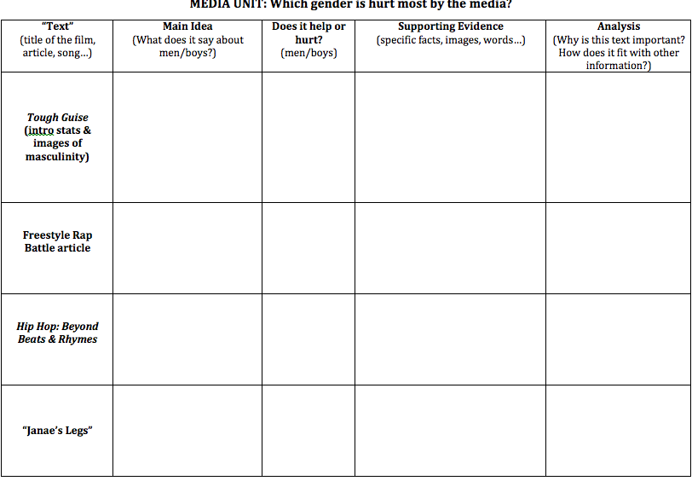
In your groups… Read “Janae’s Legs,” then fill out the row in your organizer.

Slide 5
“Janae’s Legs”
Main Idea | Help/Hurt | Evidence | Analysis

Slide 6
Are there any questions about the homework texts?

Slide 7
Seminar Tomorrow! QUESTION: Which gender is hurt more by the media: females or males? *Fill out the organizer tonight!

