Slide 1
Gender Studies MED-17 Ms. Lindsay
Aim: What is the final project for our Media Unit?
Do Now: (ON YOUR OWN): From the homework texts (yellow packet)…
Which text was the most interesting?
Which text was the most confusing?
*Any other comments or questions on the packet or the unit so far?
HW Due Today: Seminar Reflection sheet

Slide 2
FINAL PROJECT
Essential Question: What impact does the media's portrayal of gender have on its consumers?
Project: Media Critique

Slide 3
Let’s look at some examples…
Anita Sarkeesian has a ton of media critiques on YouTube (also on her site: feministfrequency.com)
Notes:
5 Creepy/Sexist Christmas Songs
Hunger Games & Katniss Everdeen

Slide 4
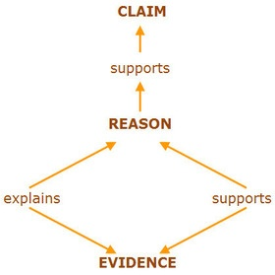

Slide 5
IN YOUR GROUP Read the text and highlight:
The CLAIM in blue
The ARGUMENTS in pink
The EVIDENCE in yellow
The ANALYSIS in green/orange

Slide 6
What you need to know…
Due: Monday, December 22
Choose a piece of media
Make a claim
Use THREE arguments to support your claim
Back up each argument with evidence & analysis

Slide 7
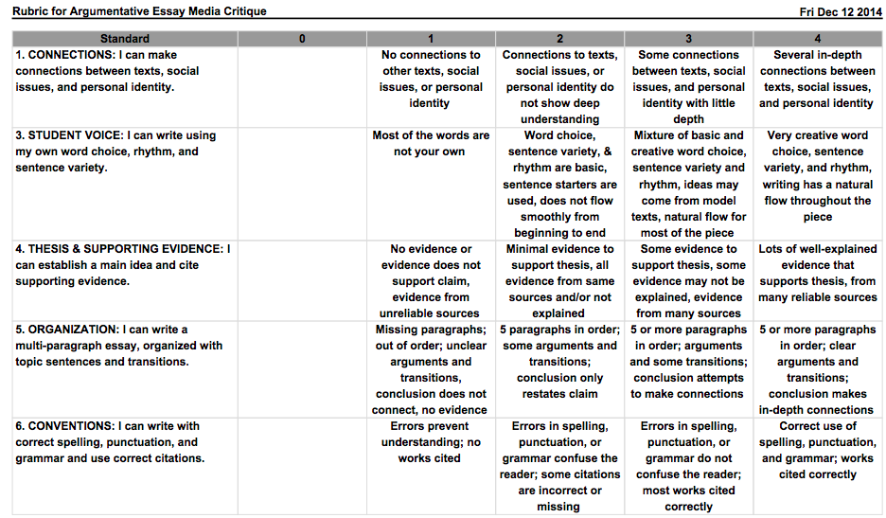
Notes:
RUBRIC

Slide 8
HOMEWORK
WRITE DOWN:
The name of a piece of media to analyze.
Does it help or hurt MEN / WOMEN?

Slide 9
IN YOUR GROUP Read the text and highlight:
The CLAIM in orange
The ARGUMENTS in pink
The EVIDENCE in yellow
The CONNECTIONS in purple
The ANALYSIS in green
Notes:
*use this slide with Sarkeesian’s Hunger Games & Katniss piece (it makes connections to other media, while the songs pieces does not)

