Slide 1
Gender Studies MED-18 Ms. Lindsay
Aim: How do we write the introduction paragraph of our media critique?
Do Now: On your own, take out a piece of paper and write:
The name of the piece of media you chose to analyze (movie, TV show, song, ad)
If it helps or hurts women/men.
HW Due Today: The name of the piece of media you chose to analyze & whether it helps or hurts women/men.

Slide 2
Student Model: Introduction
“Damn! Girl, what they feeding you?”
Being overweight is the most common
Subject to get teased about, and it’s even worse when you have the whole world on
your shoulders. As for Precious, she was
under all the subheadings: bullied, raped, illiterate, and poverty. I am an outsider looking in her shoes, and it’s quite heartbreaking to see her struggles. At a very early age, she was becoming a young adult. Hence, this film has an abundance of powerful meaning. Precious soon learns, don’t let anyone treat you less than what you’re worth.
Notes:
Kersha Wallace, October 2013, film critique essay
*grammar and punctuation have been slightly adapted for the purpose of modeling

Slide 3
Student Model: Introduction
Throughout history, women have
suffered through sexual assault, unfair
treatment, and gender inequality. Before
1975, women didn’t work at the iron
mines in Northern Minnesota. In 1975, the iron mines hired their first female miner. After that, they hired a few other women, whom they sexually harassed and treated unfairly because of their gender. One woman changed all of this, the protagonist of North Country. Josey Aimes was trying to make a living, but instead, she made history.
Notes:
Mohammed Waggeh, October 2013, film critique essay
*grammar and punctuation have been slightly adapted for the purpose of modeling

Slide 4
Model Study
Read the 2 introductions AS A GROUP
Which piece do you think is strongest?
What are 3 strengths of the piece you chose?
What is one idea for how to improve this piece?

Slide 5
Need to go to the bathroom?
Notes:
Sign language for bathroom/toilet (so students will not interrupt my academic conferences with other students to ask to go to the bathroom)

Slide 6
Write your introduction
Hook
General information about the media (use information from the seminar or text organizers)
Description of the piece of media
An original claim. (What is the message this media sends? What is the effect it has on its consumers?)
Notes:
Generate student ideas (from models & from their brains) & write in the right column

Slide 7
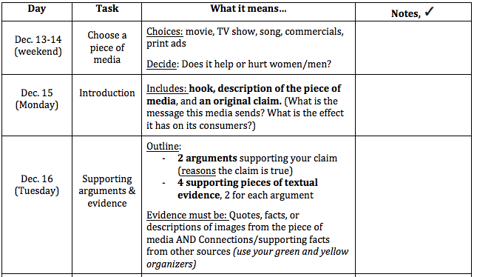
If you finish early…
✔
✔

Slide 8
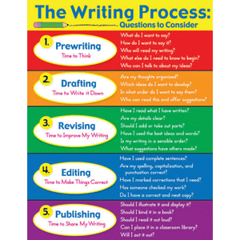
HOMEWORK
FINISH the Introduction paragraph.

Slide 9
Extra Model Intros

Slide 10
MODEL: Introduction for Ad
Advertising is a key component in today’s business world. Companies will hire professionals to capture the attention of a specific audience and convince the readers (or viewers) to buy their products. Some magazines on the market today include more advertisements than articles. This is not a terrible business move, however, as companies will pay the magazine large sums of money to print their ads. All advertisements differ from one another. Each company’s goal is for its ad to be remembered and stick out above the rest. The better the ad, the better the business.
Notes:
- Introduction of an ad analysis paper I wrote in high school

Slide 11
MODEL: Anita Sarkeesian’s Film Intro
It should come as no surprise that I’m always on the look out for dynamic, engaging, and strong female characters in pop culture and the latest fictional female representation that has everyone talking is Katniss Everdeen, the dynamic protagonist of the Hunger Games novels written by Suzanne Collins. For those unfamiliar with the trilogy, the novels are set in a future dystopian North America, in a country called Panem. The title of the book is a reference to an annual event organized by the oppressive government in which 24 children are selected at random to participate in a televised death match. In the Hunger Games, as they’re called, the children are forced to brutally murder one another until only one is left standing…In this video I’m going to focus mainly on the portrayal of Katniss’ character in the first book and the movie adaptation.
Notes:
The Hunger Games Novel and Katniss Everdeen
Anita Sarkeesian

Slide 12
MODEL: Anita Sarkeesian’s Song Intro
It’s that time of year again when regardless of whether you celebrate, enjoy, participate or even care about Christmas you’re constantly inundated with painfully cheery, sappy and repetitive Holiday music, everything from the Bing Crosby classics to the latest pop star’s rendition of jingle bells. Every store you go into, every mall you enter, and all over our television screens and radios these songs are stuck on repeat for a solid month, if not more! Those of us who happen to live in the West, probably know all the words by heart and find ourselves unintentionally singing along. But have you ever really paid attention to what’s going on in these lyrics? Some of the messages are just down right creepy and they’re passed off as holiday cheer with hardly a comment year after year.
Notes:
Five Creepy and/or Sexist Christmas Songs
Anita Sarkeesian

