Slide 1
Gender Studies MED-19 Ms. Lindsay
Aim: How do we build our arguments with evidence?
Do Now: Share your piece of media with your group. (Describe it or play/show it – if you have it with you.)
*Ask the group: What do they think about this media? How does it relate to what we have studied? How does it help/hurt?
Write down their responses.
HW Due Today: Introduction paragraph

Slide 2
What were some ideas you heard from your group?
Choose the best 2 (or 2 you already thought about)…these will be your arguments.

Slide 3
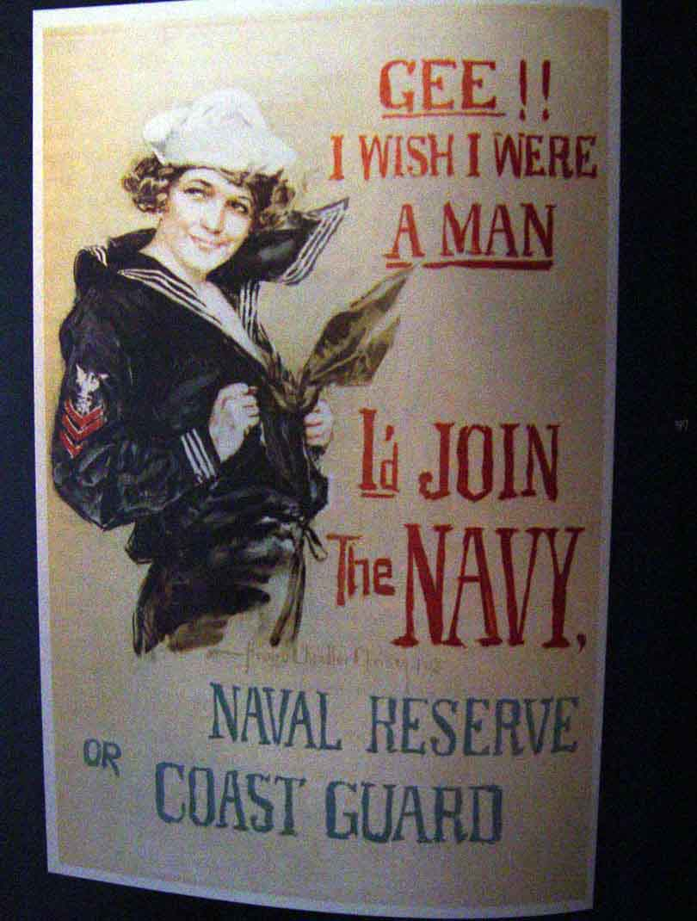
Let’s look at one together…

Slide 4
This ad shows men are hurt by the media.
ARGUMENT: Men must be strong and violent.
ARGUMENT: Men are heterosexual and should want lots of women.
Notes:
Assumes heterosexuality of all men, excludes LGBTQIA community, leads to oppression & othering, “gay” as hateful term, legal limitations (gay marriage)
Lowcut shirt on the woman, sexual pose… Nussbaum’s objectification theory (powerless, disposable…)
Historical era – other sexist ads during this time… “You mean a woman can open it?” (ketchup bottle), Leggs ad with woman as rug, head being stepped on, coffee testing – wife is spanked

Slide 5
ARGUMENT: Men must be strong and violent.
IN THE AD: woman is saying “I’d join the Navy” if she were a man
EXPLAIN: Can’t let a girl be better than you
OUTSIDE SOURCE/CONNECTION: Freestyle Rap Battle article – woman was raped, shot, burned after beating men at rap
EXPLAIN: men show dominance through violence when they are not the best

Slide 6
This ad shows women are hurt by the media.
ARGUMENT: Women are being used as sex objects.
ARGUMENT: Women are seen as weak & can not be in the military themselves.

Slide 7
ARGUMENT: Women are being used as sex objects.
IN THE AD: woman has a low cut shirt
EXPLAIN: trying to get men to join by saying women think it’s sexy; suggests women will sleep with men in the Navy.
OUTSIDE SOURCE/CONNECTION: Print ad – naked woman covered in beer bottle caps
EXPLAIN: ads show naked women when it has nothing to do with the product; not seen as human, but equal to the object for sale

Slide 8
Write your arguments and evidence
Argument 1 (reason the claim is true) | Argument 2 (reason the claim is true)
Evidence from the piece of media (quotes, facts, or descriptions of images) | Evidence from the piece of media (quotes, facts, or descriptions of images)
Evidence from other source/connection (use your green and yellow organizers) | Evidence from other source/connection (use your green and yellow organizers)
Notes:
Generate student ideas (from models & from their brains) & write in the right column

Slide 9
CLAIM
ARGUMENT
ARGUMENT
EVIDENCE from class
EVIDENCE from media
EVIDENCE from class
EVIDENCE from media

Slide 10
MODEL: Evidence/Explanation for Song
…The song “Beautiful” by Christina Aguilera is a very deep and meaningful song. She starts off the song by speaking, “Don’t look at me.” ...This song represents the side of a female that every female can relate to. Every female needs to believe they are beautiful no matter what anybody has to say about them. We are all beautiful inside and out! It’s not about what anyone thinks about you, but what you think about yourself...In the first verse, she says, “Every day is so wonderful, then suddenly, it’s hard to breathe. Now and then, I get insecure from all the pain, I’m so ashamed,” which is nothing but a fact for most women. We females have the greatest days, but once someone says something about us, we tend to break down…Then, Christina tells us women that we are beautiful in every single way.
Notes:
Santa Rolon, December 2012, song critique essay
*grammar and punctuation have been slightly adapted for the purpose of modeling

Slide 11
If you finish early…
✔
✔

Slide 12
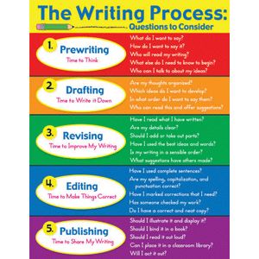
HOMEWORK
FINISH writing the arguments and evidence.
(2 body paragraphs)
***Leave space on the bottom of each paragraph for ANALYSIS

