Slide 1
Gender Studies MED-20 Ms. Lindsay
Aim: How do we analyze our evidence & connect it back to our claim?
Do Now (IN YOUR GROUP): Follow the directions on the 3rd slide on your handout.
HW Due Today: Arguments & evidence for 2 body paragraphs

Slide 2
Student Model: Analysis for Movie
[Sometimes] the victim that was raped gets tormented for speaking up and frowned upon for trying to defend him or herself. Today, there are many laws defending rape victims of all ages and all walks of life, even if there are a lot of loop holes, we are still changing and trying to make new laws and make old laws stronger and better…we also have support groups for the victim…When I have this conversation with people…they say something like “Well that’s what she gets for wearing that outfit.” That makes me mad because it shouldn’t be like that. If I wear half an outfit, it doesn’t give anyone the right to go ahead and touch me…
Notes:
Santa Rolon, April 2013, film critique essay
*grammar and punctuation have been slightly adapted for the purpose of modeling
PERSONAL/SOCIETAL CONNECTION

Slide 3
Professional Model: Evidence & Analysis for Song
…she literally says, “The answer is no” yet he ignores this and keeps persisting. The song concludes with her finally giving in with the shudder inducing line, “well I really shouldn’t….all right”. These lyrics are a perfect illustration of the way men pressure women into experiences that they don’t want, aren’t ready for or aren’t interested in. Songs like this work to normalize this problematic male behavior, a behavior, which contributes and perpetuates rape culture in general.
Notes:
Five Creepy and/or Sexist Christmas Songs
Anita Sarkeesian

Slide 4
Model Study
Read the 2 pieces of analysis AS A GROUP
Which piece do you think is strongest?
What are 3 strengths of the piece you chose?
What is one idea for how to improve this piece?

Slide 5
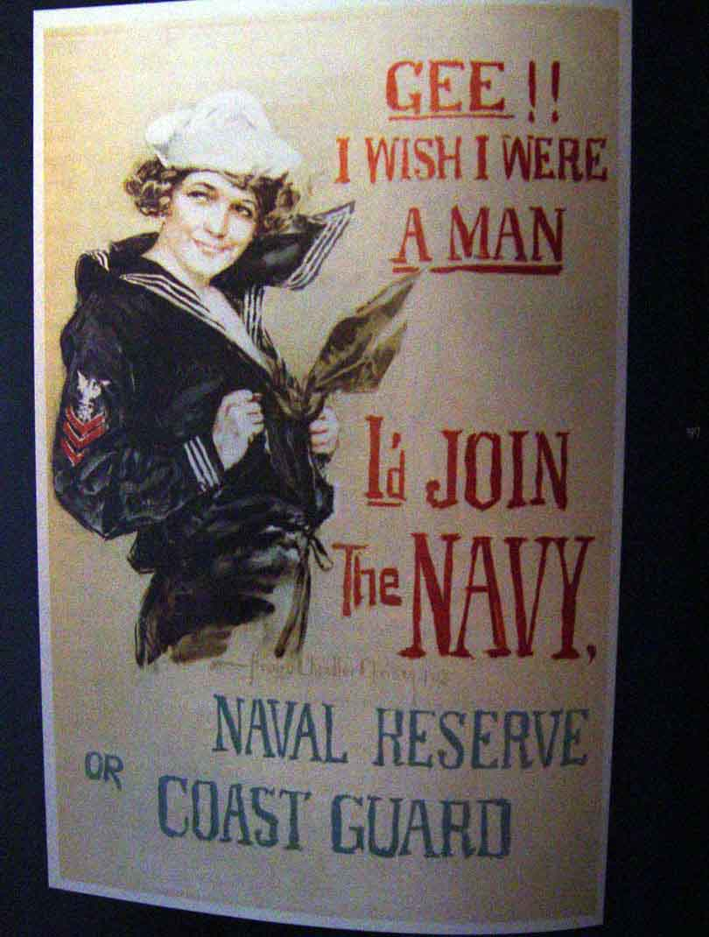
Let’s go back to this ad…

Slide 6
Men must be strong and violent.
IN THE AD: woman is saying “I’d join the Navy” if she were a man
EXPLAIN: Can’t let a girl be better than you
OUTSIDE SOURCE/CONNECTION: Freestyle Rap Battle article – woman was raped, shot, burned after beating men at rap
EXPLAIN: men show dominance through violence when they are not the best
ANALYSIS/CONNECT TO THESIS:
Men not allowed to show emotion in a healthy way – leads to violence - hurts men… go to jail, abuse women, 76% of victims are men (Tough Guise)
Military (in history): did not accept: men of color, women, gay men – message maintains hegemony
Notes:
*connect back to thesis
*intersectional analysis
*include additional fact, vocabulary, historical context (could continue to connect compare to modern day…)

Slide 7
Women are being used as sex objects.
IN THE AD: woman has a low cut shirt
EXPLAIN: trying to get men to join by saying women think it’s sexy; suggests women will sleep with men in the Navy.
OUTSIDE SOURCE/CONNECTION: Print ad – naked woman covered in beer bottle caps
EXPLAIN: ads show naked women when it has nothing to do with the product; not seen as human, but equal to the object for sale
ANALYSIS/CONNECT TO THESIS:
Women are objectified by media – leads to low self-esteem, low brain power, not running for office… (Miss Representation)
Assumes heterosexuality (men will find woman hot); woman is white – women of color DID work, white, middle-class women = privileged

Slide 8
Write your analysis
 | ARGUMENT/EVIDENCE 1 | ARGUMENT/EVIDENCE 2
Why is it important? (Connect it back to your claim) *REMEMBER, you are ARGUING!
Intersectionality (How does it connect to other parts of identity?)
Vocabulary (words that relate to this argument)
Notes:
Generate student ideas (from models & from their brains) & write in the right column

Slide 9
If you finish early…
✔
✔

Slide 10
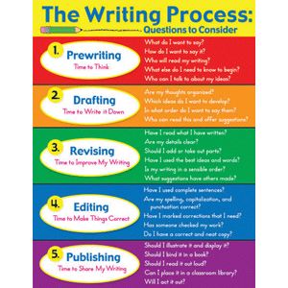
HOMEWORK
FINISH 2 body paragraphs (arguments, evidence, analysis)

Slide 11
Extra Analysis pieces

Slide 12
Professional Analysis: Evidence & Analysis for Movie
Later [in the Capitol], Katniss has a panic attack, and believes for a moment she’s back in the arena. She imagines the medical staff as a pack of [dogs] attacking her friend. These examples are evidence of the delusion and paranoia that Katniss understandably suffers as a result of the extreme trauma she experienced during the Hunger Games. These scenes help to separate her from many of the so called strong female characters in popular culture who just replicate the…unemotional, unaffected, macho [stereotype] where somehow they go through extreme violence and trauma with no visible effect at all. So it’s refreshing that Katniss is allowed to go through a period of post traumatic stress and that the emotional experience ultimately works to make her a stronger character, rather than a weaker one.
Notes:
The Hunger Games Novel and Katniss Everdeen
Anita Sarkeesian

Slide 13
Student Model: Analysis for Movie
This film deals with the difference between men and women. Men are shown as aggressive and having power over women. Women were shown as men’s property. Men could use and do whatever they wanted to the women. There were not people of different races represented in the film. There was only one race, which was white…The theorist who discussed this was Sojourner Truth, who asked, “Ain’t I a Woman?” She also said that black women are not treated like white women. She highlights difference between women of different races and classes…
Notes:
Mohammed Waggeh, October 2013, film critique essay
*grammar and punctuation have been slightly adapted for the purpose of modeling
INTERSECTIONAL ANALYSIS – gender/class

