Slide 1
Gender Studies MED-21 Ms. Lindsay
Aim: How do we write our opposing claim paragraph?
Do Now (IN YOUR GROUP): Describe your piece of media to your group, and tell them your claim. Ask them what other claims could be made about your piece of media. WRITE DOWN THEIR IDEAS.
HW Due Today: Completed 2 body paragraphs (arguments, evidence, analysis)

Slide 2
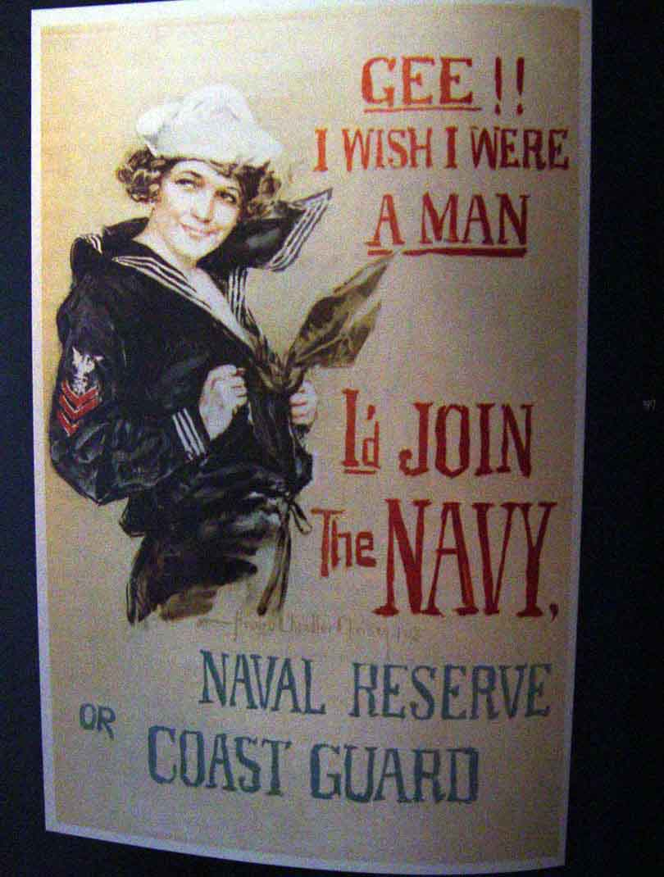
Let’s go back to this ad…

Slide 3
This ad hurts men
COUNTERCLAIM
She can only join if she is a man (only men can fight & die in war)
EVIDENCE
from piece of media
As you can see, this ad hurts women more.
REFUTE (Why THEY are wrong)
Women are shown as weak, can’t do anything
- Nussbaum’s objectification theory - women are powerless, property, & disposable
- Video games – men fight & kill; girls are for sex
CONNECT back to CLAIM

Slide 4
Write your opposing claim
1 piece of evidence from the piece of media (Quote, fact, or description of an image) | Some people say…this ad hurts men more. EVIDENCE: She can only join if she is a man (only men can fight & die in war)
Refutes (ARGUES) the opposing claim | REFUTE: women shown as weak, can’t do anything themselves → Nussbaum’s objectification theory - women are powerless, property, & disposable In video games: men shoot & girls are for sex
Connect back to claim | CONNECT BACK TO MY CLAIM: As you can see, this ad hurts women more.
Notes:
Generate student ideas (from models & from their brains) & write in the right column

Slide 5
OPPOSING CLAIM
EVIDENCE
from piece of media
REFUTE (Why THEY are wrong)
CONNECT back to CLAIM

Slide 6
If you finish early…
✔
✔

Slide 7
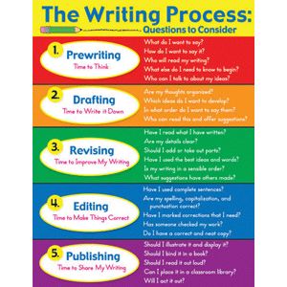
HOMEWORK
FINISH opposing claim paragraph AND conclusion paragraph
Restate claim
Summarize arguments
Closing statement (why it’s important to analyze the media, connection to today…)

