Slide 1
Gender Studies MED-25 Ms. Lindsay
Aim: How can we publish our writing so it reaches a BIG audience?
Do Now (ON YOUR OWN): Reflect on the media critique project and the whole media unit.
What did you like?
What would you change?
What was your biggest take-away? (Something you learned that stayed in your mind.)
HW Due Today: You should be finished with editing your paper. Email it to me at LYONS.LB@gmail.com

Slide 2
Twitter
“ As of December 2014, Twitter has more than 500 million users…”

Slide 3
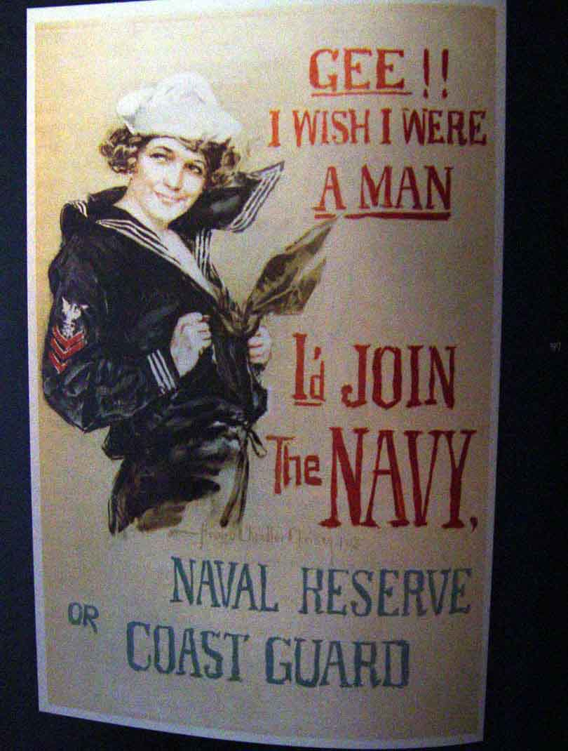
MODEL
U S I N G W O M E N ‘ S B O D I E S A S R E W A R D S T O B E C L A I M E D P E R P E T U A T E S R A P E C U L T U R E . B A N A D S T H A T O B J E C T I F Y W O M E N . W E C A N D O B E T T E R . #genderstudiesforall

Slide 4
Twitter Handle
@lyons_lb
#genderstudiesforall

