Slide 1
Gender Studies MED-3
Ms. Lindsay
Aim: How does the media objectify women?
Do Now: ON YOUR OWN…complete the Do Now sheet.
HW Due Today:Main Idea & Connections for video (“How the Media Failed Women in 2013”)

Slide 2
Nussbaum’s 7 Types of Objectification
Instrumentality. Women treated as tools
Denial of autonomy. Women are under control of men
Inertness. Women can’t make decisions on their own
Fungibility. All women are the same, replaceable
Violability. It’s ok to break, hurt women
Ownership. Women can be bought & sold
Denial of subjectivity. Women’s feelings are not important
Notes:
*For ease of explanation, I use the term women to represent those objectified, but women are not the only gender that is objectified

Slide 3
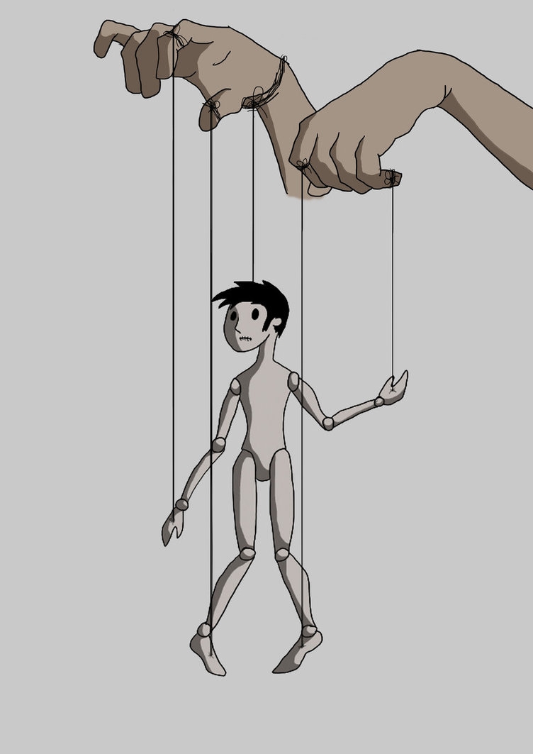
Powerless
Notes:
Denial of Autonomy (controlled by men) /Inertness (can’t do anything on own)
Women have no power, they are controlled by men & cannot do anything without men

Slide 4
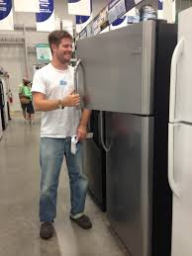
Property
Notes:
Instrumentality (tools) /Ownership (can be bought/sold)
Men can buy/own women, men can do whatever they want with women

Slide 5

Disposable
Notes:
Denial of subjectivity (feelings - not important) / Violability (ok to break/hurt) / Fungibility (replaceable)
Women are easy to buy (cheap), replaceable, throw out after using once

Slide 6
For each advertisement…
What type of objectification is shown?
Give evidence to support your answer.

Slide 7
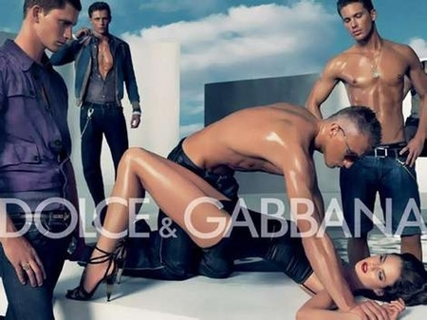

Slide 8
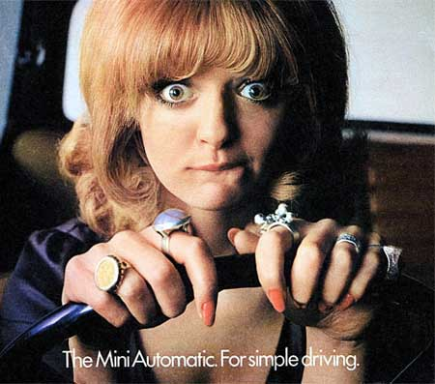

Slide 9


Slide 10
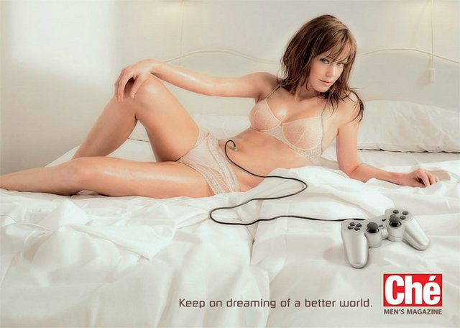

Slide 11


Slide 12


