Slide 1
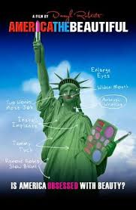
Gender Studies MED-6 Ms. Lindsay
Aim: How do messages from the media affect women in our society?
Do Now: In your group…Predict
what the film America the Beautiful
will be about.
HW Due Today: Main idea &
connections for video & article
about women in video games

Slide 2
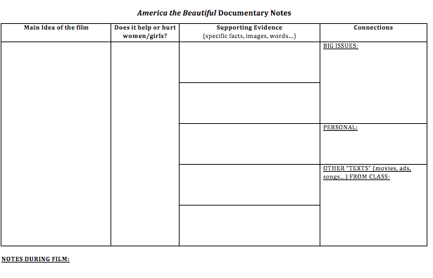
Notes:
MI: Media shows “perfect” (not real) women, and girls feel bad about themselves.
H/H: Media = hurts; This film = helps
Evidence: Dove’s “real” women need firming lotion; Woman’s butt used to promote video game; Only photo-shopped women are pretty; Fiji – 3 yrs of TV changed “beauty” ideas; Shows photo-shopped woman (Dove)

Slide 3
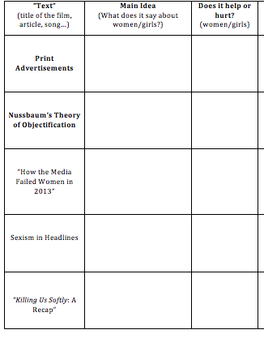
HOMEWORK
By MED-10 (Nov. 20th),
you must finish this packet.
YOU MUST COMPLETE:
All of the bold “texts” &
Choose 4 other “texts”
MORE than 4 = extra credit

