Slide 1
Gender Studies MED-7 Ms. Lindsay
Aim: How are children’s ideas of gender affected by the media?
Do Now (ON YOUR OWN): Growing up, what kinds of media (TV shows, movies, songs, magazines, news…) did you consume and how did it affect your ideas about gender?
HW Due Today: Keep working on the organizer!
*Let me know if you want a HW chart!

Slide 2
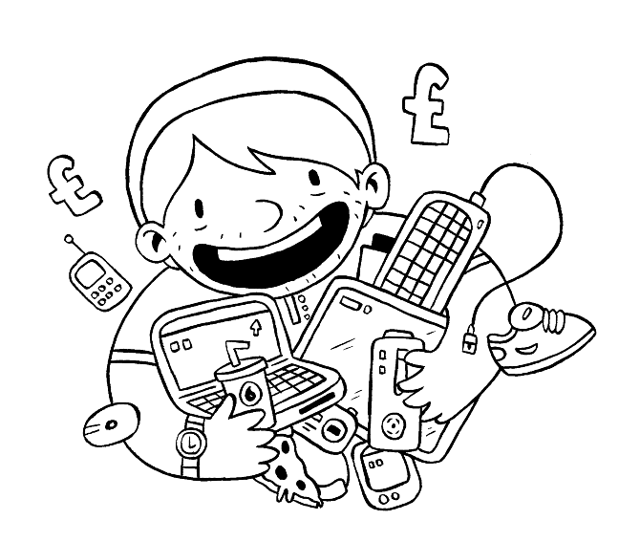
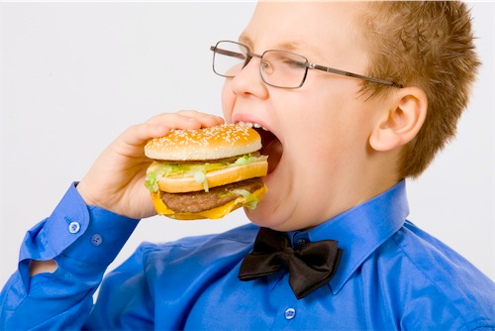
VOCABULARY
Consume –
Notes:
to buy or use, eat up
Forms of the word, use it in a sentence

Slide 3
Did you watch Disney movies? What do you think about Disney movies? Would you show them to your kids?

Slide 4
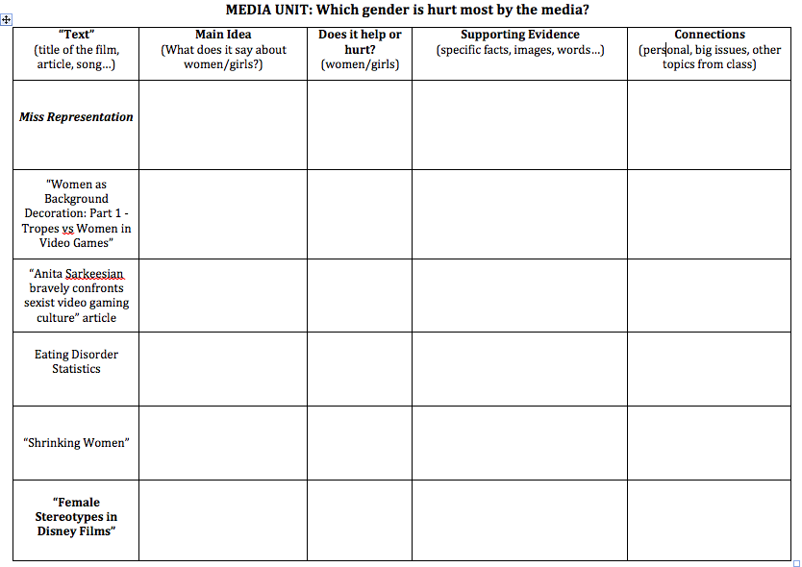
In your groups, fill out the row of your organizer (the green packet) that says: “Female Stereotypes in Disney Films.”

Slide 5
Females in Disney
Main Idea | Help/Hurt | Evidence | Connection
Notes:
MI: Women are treated abusively (They should sacrifice for love.)
H/H: Hurt
Evidence: Little Mermaid – beauty is all that matters (Ariel gave up her voice for a man)
Connections: Sexism; Miss Representation (women in power judged by looks, cutting, eating disorders); Video games

Slide 6
Is it okay to call girls “pretty?”

Slide 7
In groups, read the article. Then, fill out the row of your organizer that says: “How to Talk to Little Girls” article.

Slide 8
Girls Pretty article
Main Idea | Help/Hurt | Evidence | Connections
Notes:
MI: When you talk to girls about looks, they think that’s what people notice first.
H/H: Help – author’s ideas; Hurt – society
Evidence: Strategy – talk to girls about books NOT looks; Half of girls 3-6 worry about being fat
Connections: Disney stereotypes of women

Slide 9
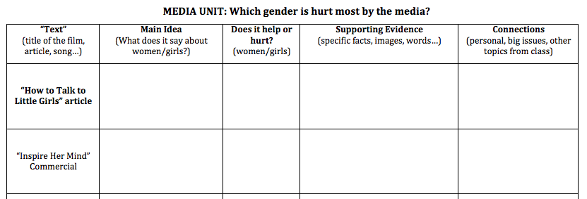
HOMEWORK: genderstudiesforall.weebly.com
Continue to watch/read (at least 4 of the 8) “texts” online. After you have watched them, fill that row of your organizer.

Slide 10
For anyone interested, in a Disney & Sexuality article, the following slides chunk the information from an interesting article.

Slide 11
What messages about sexuality does Disney teach to kids?
“Queering” Disney
By Brandie, trueclassics.net
...Homosexuality is about as welcome in a Disney film as a bear to a honey party (unless that bear is Winnie the Pooh, of course)…
But some…characters are drawn to appear “othered” in comparison to sexual “norms”…
Notes:
The following slides are excerpts…

Slide 12
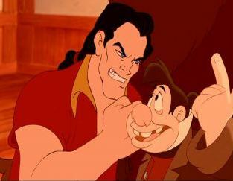
LeFou, Beauty and the Beast
LeFou is Gaston’s right-hand man, and as such, he has many roles in the film: ego stroker, punching bag, errand boy
LeFou is short and fat as opposed to Gaston’s… manliness (which LeFou [praises] in one of the funniest songs in the Disney songbook. I dare you not to laugh when Gaston brags that he is “especially good at EXPECTORATING!” After all, the ability to spit is the ultimate sign of a man’s man).
LeFou is abused and serves as the butt of the jokes–and takes on the brunt of Gaston’s anger. He never takes initiative to step outside of that role, seeming content to be a lackey and soak up whatever leftover adoration he can get from Gaston’s many admirers.
Essentially, what the characterization of LeFou tells us is that the less masculine you are, the more of a bumbling [idiot] you may be. And you will certainly never get the girl—in fact, the girls will laugh at you while fawning over your ripped (and equally idiotic) friend.

Slide 13
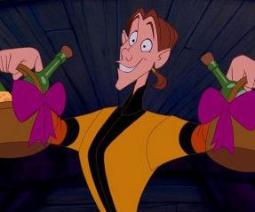
Wiggins, Pocahontas
He makes gift baskets for the Natives and acts as a glorified hairdresser to Percy the dog.
The manservant to the evil Governor Ratcliffe (who is himself depicted as being fairylike), Wiggins is shown to be little more than a weak, skinny beanpole, practically frightened of his own shadow and looked at by the other men as being of absolutely no use in the brewing conflict between the Natives and the Englishmen.
He is undeniably one of the more overly effeminate characters, down to his vocalizations (“Ooh, gift baskets!”) and his hip-shaking movements across the screen.

Slide 14
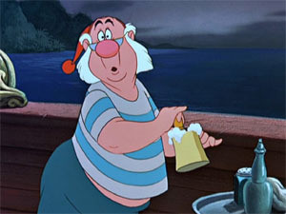
Smee, Peter Pan
It’s hard to determine why, exactly, Smee remains so loyal to his boss, Captain Hook (who, again, is painted with own…feminine…qualities).
In comparison to Hook, Smee is kind and gentle, concerned about others, and loyal to a fault. He helps Hook in his evil deeds, but there’s always a sense of reluctance.
He’s weak physically and weak-willed, in many ways, allowing Hook to push him around, but at the same time, the relationship between the two is painted almost like a marriage, with Smee in the [submissive] “wifely” role.

Slide 15
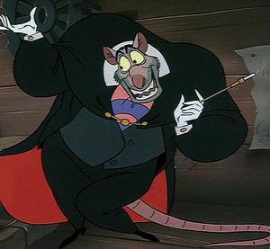
Ratigan, The Great Mouse Detective
The extremely theatrical Ratigan’s love for champagne, caviar, and the finest in designer rat threads already mark him as different from the other rats (or mice, as it were, as Ratigan tends to lose his [mind] whenever anyone calls him a “rat”), showing that he is of an entirely separate rank, at least in light of the caste system of the rodent underground.
But it’s his desire to take over for Queen Mousetoria–to essentially “become” the Queen–that truly marks him as an other–especially if you take that goal somewhat literally.

Slide 16
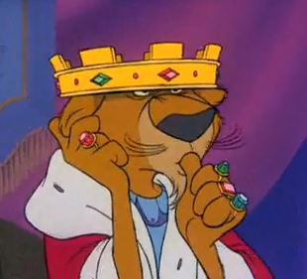
Prince John, Robin Hood
He has “mommy issues,” and throughout much of the film, he’s shown sucking his thumb while tugging on his ear.
Need I say more?

Slide 17
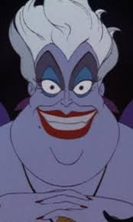
Ursula, The Little Mermaid
Her lust for Ariel’s voice could be [seen] as…lust for the mermaid herself

Slide 18
Stereotypes
Gay figures [using] effeminate gestures, swishing across the screen and swinging their hips in wild exaggeration…have been…in films for one hundred years, and are still presented in modern-day movies as a way of [showing] a character’s sexual [orientation] without having to outright state it.
At its heart, it’s not only horrifyingly judgmental and biased, but it’s also a mark of lazy filmmaking and a lack of desire to characterize gay figures as something deserving of respect.

