Slide 1
Gender Studies MED-9 Ms. Lindsay
Aim: What rules does the media have to follow?
Do Now (IN YOUR GROUP): Answer...
Do you think the media has to follow rules?
What do you think the rules are?
Who makes the rules for the media to follow?
HW Due Today: Your organizer is due today!

Slide 2
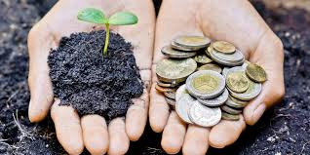
VOCABULARY
Corporate social responsibility –
Notes:
companies should help the society

Slide 3
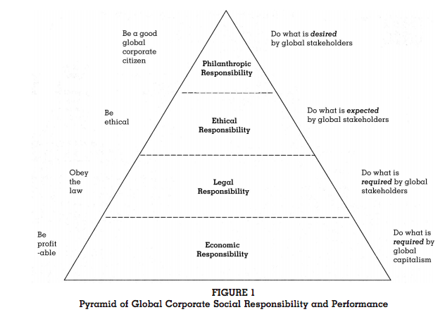
Are these levels of responsibility mutually exclusive?
Notes:
Can you make money and be socially responsible at the same time?

Slide 4
Study Shows…
…80% of Americans say they feel better about companies that are aligned with social issues.
2/3 of us say we would switch to a brand that supports a good cause.
Notes:
From a 2004 study - http://www.aef.com/on_campus/classroom/speaker_pres/data/3001

Slide 5
Guiding Principles on Business and Human Rights United Nations Human Rights, 2011
I. State responsibility
States must protect against human rights abuse within their territory…by businesses… This requires taking…steps to prevent…punish and [fix] such abuse through effective [laws]
II. Corporate responsibility
…[They should try] to prevent…[human rights abuses] that are…linked to their…products…
Notes:
What do you notice about the language in this document?
How does the UN enforce “guidelines”?

Slide 6
The US representative told the committee, “The United States will not participate in this…and we encourage others to do the same.”
Notes:
“Binding and non-binding as they please” article by Thalif Deen, The Nation

Slide 7
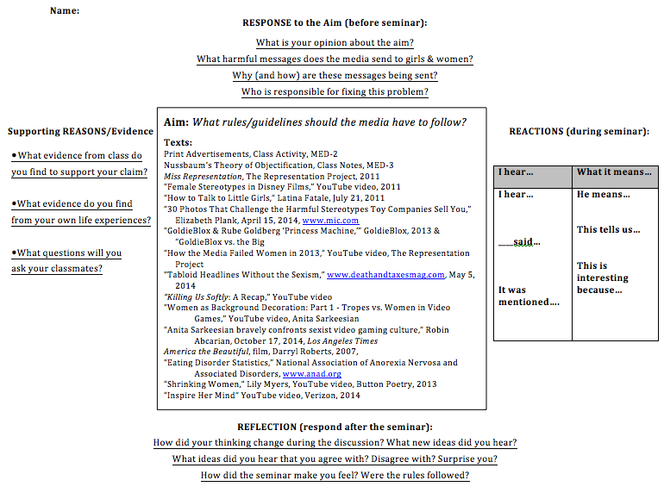

Slide 8
