Slide 1
STEPS OF A NEW WORD SORT:
1. Determine the pattern. Write the category titles.
Notes:
Steps & images on this slide from www.thisreadingmama.com

Slide 2
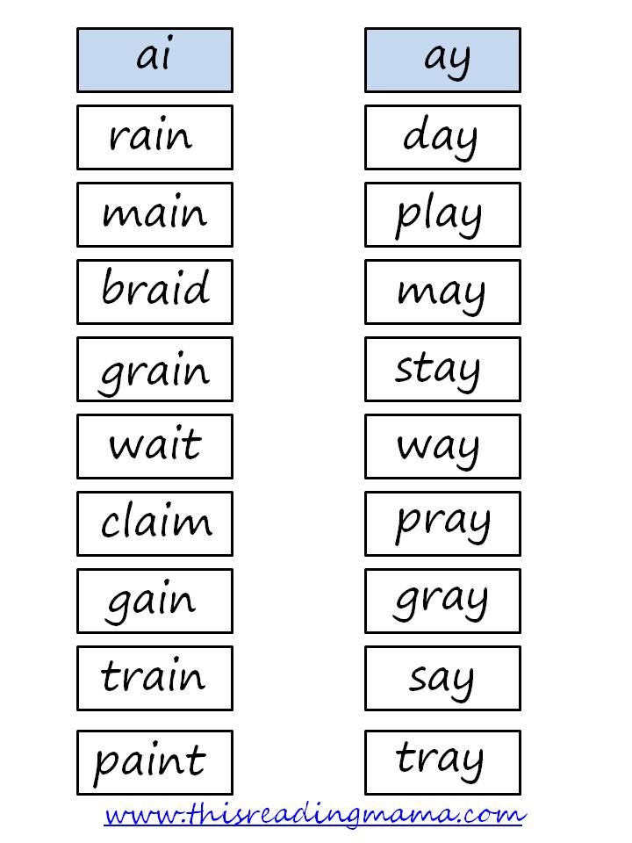
STEPS OF A NEW WORD SORT:
2. Read words you know, first. Sort them into the correct category.
3. Finish sorting all of the words.
Notes:
Steps & images on this slide from www.thisreadingmama.com

Slide 3
STEPS OF A NEW WORD SORT…
5. Make sure you know what each word means! If you have never heard of a word, ask for help! “What does this word mean?”
6. What do you notice about the words in each category? How are they the same?
7. Write the words into your notebook. (Keep the categories separate.)
Notes:
Steps (excerpted) from www.thisreadingmama.com

Slide 4
WORD SORT ACTIVITIES (What to do next…)
Blind sort: Your partner reads a word, but does NOT show you the word. You will listen to the word, and point to the name of the category it is in.
Written sort: Your partner reads a word, but does NOT show you the word. You will listen to the word, and spell the word.

Slide 5
HOMEWORK
Word hunts: During the week, look for words that fit into the categories. When you find one, write it in your notebook, in the correct category.

Slide 6
SHORT VOWEL SOUNDS CVC

Slide 7
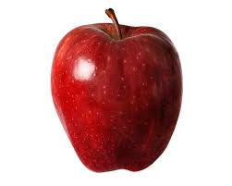
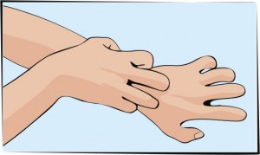
WORDS FOR SHORT VOWEL SOUNDS:
Apple
Edge
Itch
Octopus
Up

Slide 8
_A_
Bad
Sad
Sat
Rat
Lap
Hat

Slide 9
The net got wet. It is fun to run and win. Dan ran to the pan. The pig is fat. The pup can run on the rug.
Notes:
CVC sentences

Slide 10
Beginning Blends
Ending Blends
scab
desk

Slide 11
GAME TIME!
TEAM 1 | TEAM 2 | TEAM 3 | TEAM 4 | TEAM 5

